Slide 1
The Three Stream Hypothesis
Rizzolatti & Matelli (2003)

Slide 2
Talk Outline
Stream Localization
Lesional Correlates
Parieto-Premotor Circuits
Stream Topology

Slide 3

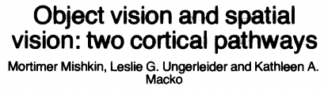
Two Dual Stream traditions
“What” stream & “How” stream
Goodale & Milner (1992)
Jeannerod (1994)
“What” stream & “Where” stream
Mishkin et al (1982)

Slide 4
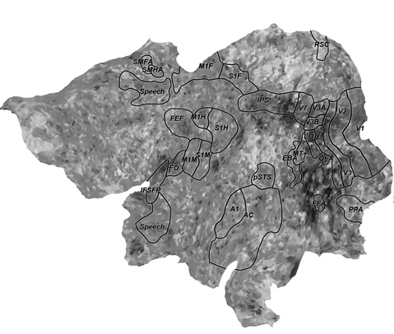
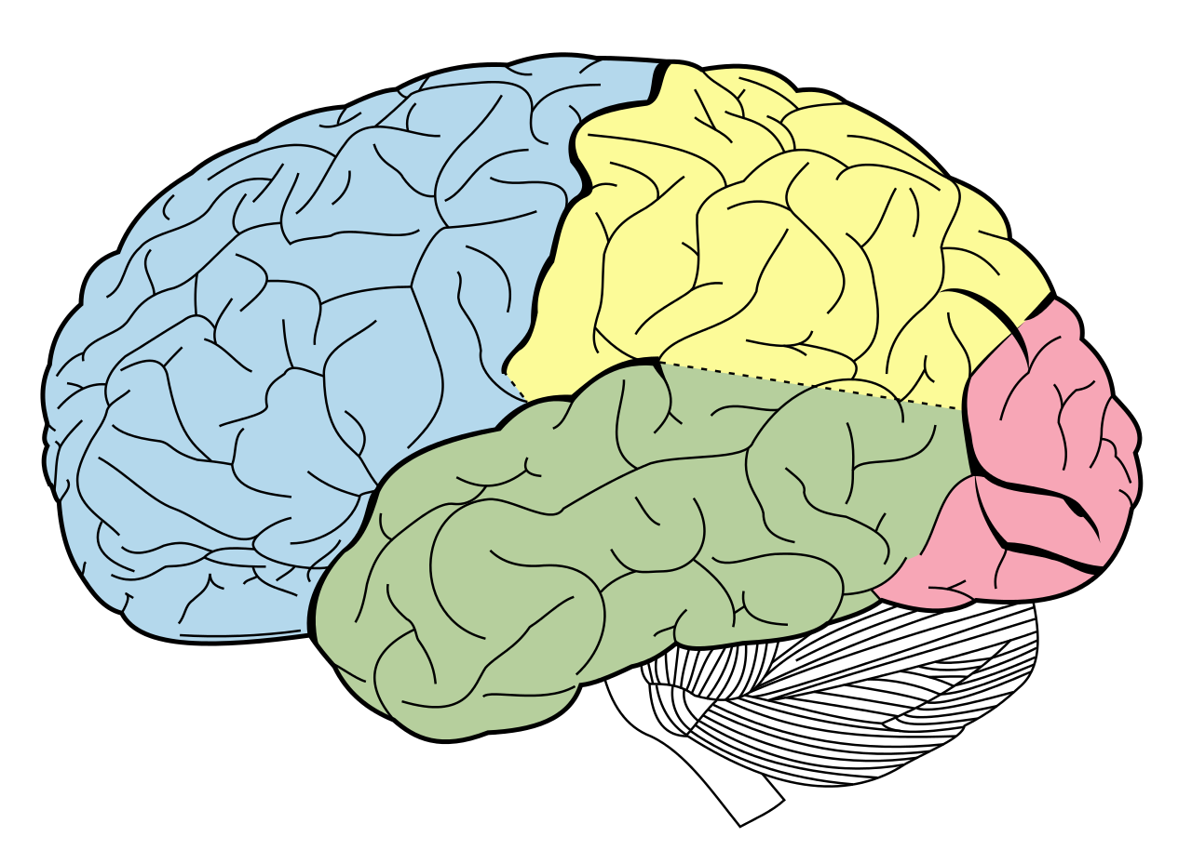
Left Hemisphere Flat Map
Limbic
Lobe
Parietal
Lobe
Parietal
Lobe
M1/S1
Frontal
Lobe
Fro
Occipital
Lobe
V1
Temporal
Lobe
A1
P
F
O
T

Slide 5
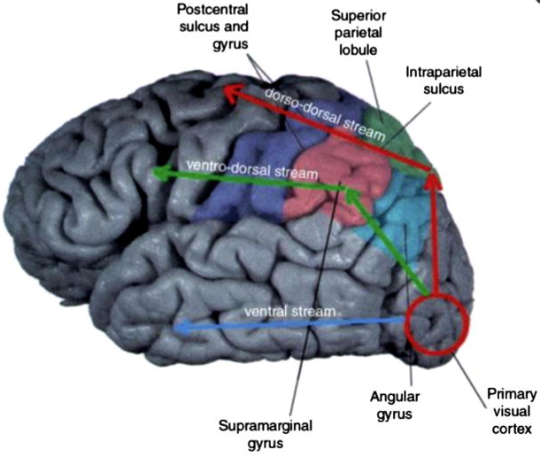
Three Streams: “How”, “Where”, “What”
Dorso-Dorsal “How” Stream
Ventro-Dorsal “Where” Stream
Ventral “What” Stream
PMd
SPL
smG
anG
PMv

Slide 6
Reconciling The Traditions
Dorso-Dorsal “How” Stream
Perceptually Guides Action
Goodale
& Milner
Ventro-Dorsal “Where” Stream
Supports Spatial Reasoning
PMd
SPL
Ventral “What” Stream
Computes Object Features
Mishkin et al
smG
anG
PMv
Notes:
The ventral stream ascribes features to visual objects “What”.
The ventro-dorsal stream supports spatial reasoning “Where”.
The dorso-dorsal stream perceptually guides action “How”.

Slide 7
Bisecting Ventro-Dorsal Stream
The ventro-dorsal stream (IPL & vPMC) exhibits strong lateralization effects.
The right ventro-dorsal stream supports spatial reasoning and attention.
The left ventro-dorsal stream computes affordances.
The other streams show less evidence of lateralization.

Slide 8
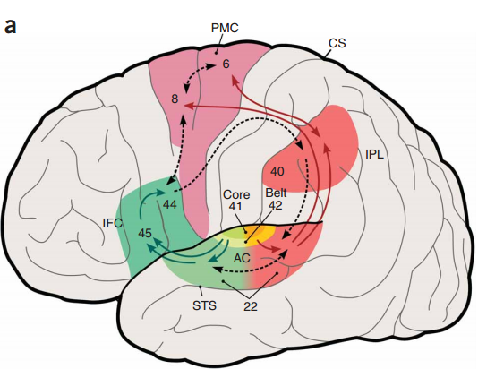
Dual Stream Models of Speech Processing
In recent years, dual stream models of speech processing have been put forward.
Rauscheck & Scott (2009). Maps and streams in the auditory cortex: nonhuman primates illuminate human speech processing
Hickok & Poeppel (2007). The cortical organization of speech processing
In this literature:
Left lateral stream: speech production
Right lateral stream: audio spatial analysis
Ventral stream: audio features & speech comprehension.
We can integrate these models into the Three Stream Hypothesis

Slide 9
Integrating Audition
Dorso-Dorsal “How” Stream
Ventro-Dorsal “Where” Stream
Ventral “What” Stream
PMd
SPL
smG
anG
PMv
Primary
Audio
cortex

Slide 10
Summing Up
Dorso-Dorsal “How” Stream
Dorso-Dorsal Dorsal “How” Stream
Ventro-Dorsal “Where” Stream
Ventro-Dorsal Lateral “Where” Stream
Ventral “What” Stream
Ventral “What” Stream
Let’s rename our streams...
Posterior
Parietal
Cortex
PMd
SPL
Prefrontal
Cortex
Premotor
Cortex
Superior Parietal Lobule (SPL)
IPL
PMv
Dorsolateral PFC (DLPFC)
Dorsal Premotor
(PMd)
Intraparietal Sulcus (IPS)
Ventrolateral PFC (VLPFC)
Ventral Premotor
(PMv)
Inferior Parietal Lobule (IPL)
Notes:
The ventral stream ascribes features to visual objects “What”.
The ventro-dorsal stream supports spatial reasoning “Where”.
The dorso-dorsal stream perceptually guides action “How”.

Slide 11
Talk Outline
Localizing The Streams
Lesional Dissociations
Identifying Parieto-Premotor Subcircuits
Stream Topology

Slide 12
Blindsight
Lesions to V1 eliminate conscious experience of vision.
However, some visual information reaches the dorsal stream, via the pulvinar.
This “leakage” produces the phenomenon of blindsight:
People unable to tell you where objects are, but when forced to guess, will get it right far above chance levels.
This was the original motivation for Goodale/Milner’s “How” visual stream.

Slide 13
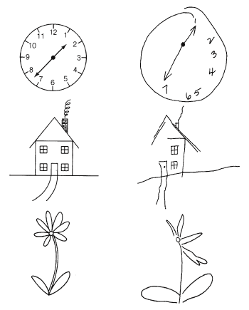
Hemispatial Neglect
Patient’s Drawing
Model
Neglect is an attentional disorder.
Hemispatial neglect is an impaired ability to attend to one half of space.
Hemispatial neglect is much more common for the left hemifield.
Itis associated with lesions in the right lateral stream.

Slide 14
Lesional Evidences
Optic ataxia is a reaching disorder, most pronounced when object is in peripheral vision.
This disorder is caused by lesions on SPL.
Apraxia is an impaired ability to make gestures. Ideomotor apraxia has this impairment only when subject is not in an appropriate context.
This disorder is caused by lesions on IPL.

Slide 15
Lesions & Streams
We can see a taxonomy of lesions begin to emerge, based on which stream has been compromised.
Ventral stream
Dorsal stream
Left lateral stream
Right lateral stream
Neurotypical
Optic Ataxia
Hemispatial Neglect
Ideomotor Apraxia
Blindsight

Slide 16
Talk Outline
Stream Localization
Behavioral Correlates
Parieto-Premotor Circuits
Stream Topology

Slide 17
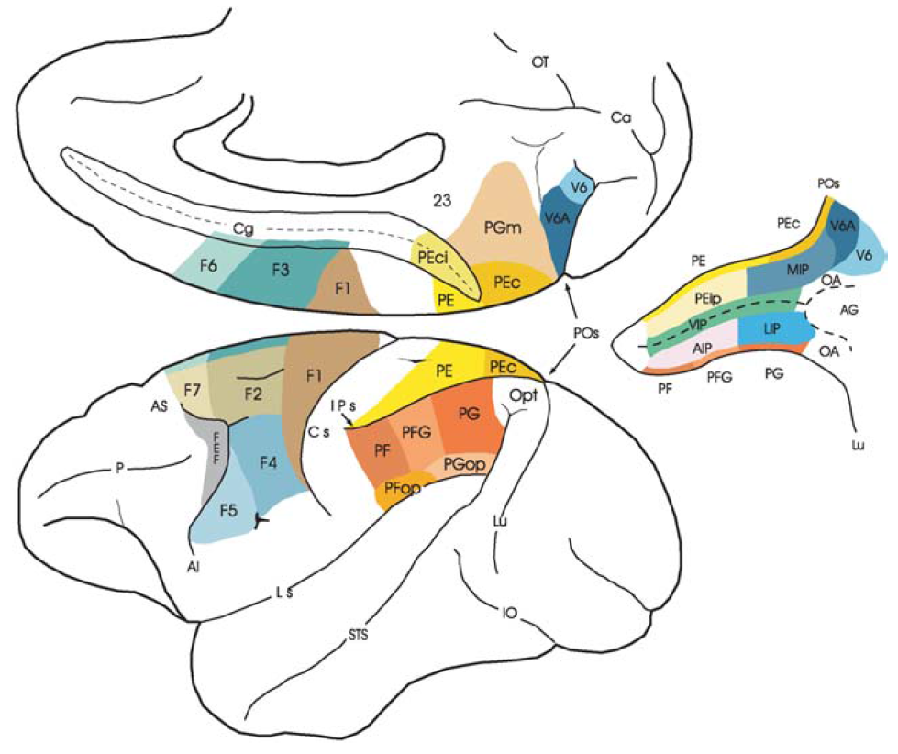
Improving Parcellation Granularity
Dorsal Stream
Lateral Stream
Ventral Stream
Posterior
Parietal
Cortex
PMd
SPL
Prefrontal
Cortex
Premotor
Cortex
PE
PEc
Superior Parietal Lobule (SPL)
IPL
PEip
MIP
PMv
F7
F2vr
Dorsolateral PFC (DLPFC)
Dorsal Premotor
(PMd)
F2d
VIP
Intraparietal Sulcus (IPS)
F5ab
F4
Ventrolateral PFC (VLPFC)
Ventral Premotor
(PMv)
AIP
LIP
F5c
Inferior Parietal Lobule (IPL)
PF
PFG
PG

Slide 18
Five Circuits
Posterior
Parietal
Cortex
Lateral circuits
VIP→F4: Reaching & Peripersonal Space
AIP→F5ab: Grasping Objects
PF→ F5c: Action Understanding
Premotor
Cortex
PE
PEc
F7
F2vr
PEip
MIP
F2d
F5ab
F4
VIP
Dorsal circuits¹
PEc / PEip → F2d: Online Guidance
MIP → F2vr: Visuomotor transformations
F5c
AIP
LIP
PF
PFG
PG
1. Matelli et al (1998). Superior Area 6 Afferents From the Superior Parietal Lobule in the Macaque Monkey

Slide 19
Peripersonal Space
The perceptual difference between an object 2ft and 6ft away is not especially large.
However, only objects in peripersonal space can be reached by the organism.
The brain has a separate system which elaborates nearby affordances.
This dissociation is evidenced by peripersonal neglect.
Peripersonal
Space
Extrapersonal
Space

Slide 20
VIP → F4: Reaching & Peripersonal Space
F4 fires during arm and hand reaching movements.
Electrical microstimulation induce a variety of shoulder, neck, and face movements.
Lesions can induce both contralateral peripersonal neglect, and motor disorders
PE
PEc
F7
F2vr
PEip
MIP
F2d
F5ab
F4
VIP
F5c
AIP
LIP
PF
PFG
PG

Slide 21
About F5
Trimodal (audio/visual/haptic) neurons have been discovered throughout F5.¹
This region seems to participate in the audio lateral stream.
The human analogue to macaque F5 is BA45: Broca’s Area Pars Opercularis.
PE
PEc
F7
F2vr
PEip
MIP
F2d
F5ab
F4
VIP
F5c
AIP
LIP
PF
PFG
PG
1. Rizzolatti, Fogassi, Gallese (2002): Motor and cognitive functions of the ventral premotor cortex

Slide 22
AIP → F5ab: Grasping
F5 neurons encode hand and mouth movements.
Three classes of AIP neurons: visual dominant, bimodal, motor dominant.
PE
PEc
F7
F2vr
PEip
MIP
F2d
F5ab
F4
VIP
F5c
AIP
LIP
Grasp in daylight
Grasping in darkness
PF
PFG
PG
Visual
Dominant
100%
0%
Bimodal
100%
50%
Haptic
Dominant
100%
100%

Slide 23
PF → F5c: Action Understanding
F5c, the dorsal section of Pars Opercularis, contains mirror neurons.
Mirror neurons have two interesting properties:
Their representations are person-agnostic.
They enable percept-motor transduction.
They are generally viewed as facilitating action understanding.
However, they may also be an important prerequisite for language.
PE
PEc
F7
F2vr
PEip
MIP
F2d
F5ab
F4
VIP
F5c
AIP
LIP
PF
PFG
PG

Slide 24
Summarizing The Parieto-Premotor Circuits
Dorsal circuits: Online Guidance, Visuomotor transformations
These circuits enable dynamic behavior patterns (variable affordances¹)
Lateral circuits: Reaching & Peripersonal Space, Grasping Objects, Action Understanding
These circuits enable long-term behavioral memory (stable affordances)
What became of the “What” vs “Where” distinction?
SPL
IPL
1. Binkofski, Buxbaum (2012) Two action systems in the human brain.

Slide 25
Talk Outline
Stream Localization
Behavioral Correlates
Parieto-Premotor Circuits
Stream Topology

Slide 26
Broader View Of Streams
Dorsal Stream
Lateral Stream
Ventral Stream
We’ve examined parietial → premotor circuits.
PMd
SPL
But what circuits operate earlier (extrastriate)?
IPL
PMv
And later (prefrontal)?

Slide 27
Three Stages
Color Key
Perception Area
Action Area
Stage Three
Stage Two
Stage One
DLPFC
PMd
Variable
Affordances
SPL
M1
S1
VLPFC
PMv
Stable
Affordances
IPL
V1
TE
TEO

Slide 28
Searching for “What” vs “Where”
Dorsal Stream
Lateral Stream
Ventral Stream
We can abbreviate stream-stage pairs:
“Dorsal Stream, Stage 2” → DS2
Extrapersonal space isn’t encoded by DS2 or LS2.
So let’s turn to LS1 and VS1.
DS2
DS3
PMd
DS1
LS2
LS3
PMv
LS1
VS1
VS2

Slide 29
Dual-Representation Categories
Dorsal Stream
Lateral Stream
Ventral Stream
Regions of interest (ROIs) come in pairs.
We don’t have one face selective area, but two.
These pairs are clustered in two regions.
PMd
DS2
DS3
DS1
Lateral
Stream
Ventral
Stream
LS2
PMv
Objects
LO
pFs
LS3
Bodies
EBA
FBA
Faces
EFA
FFA
VS2
Places
TOS
PPA
These regions correspond with different functions:
The lateral region encodes location.
The ventral region encodes features.
1. Schwarzlose et al (2007). The distribution of category and location information across object-selective regions in human visual cortex.
Notes:
The ventral stream ascribes features to visual objects “What”.
The ventro-dorsal stream supports spatial reasoning “Where”.
The dorso-dorsal stream perceptually guides action “How”.

Slide 30
The Three Streams Hypothesis
Color Key
Perception Area
Action Area
Stage Three
Stage Two
Stage One
Dorsal
Stream
DLPFC
PMd
Variable
Affordances
SPL
M1
S1
Lateral
Stream
Stable
Affordances
Locations
VLPFC
PMv
IPL
V1
Speech
Comprehension
A1
Features
Speech
Production
Ventral
Stream
AC
TE
TEO

