Slide 1
Bayesian Reasoning

Slide 2
2.1) Bayesian Inference is Reallocation of Credibility Across Possibilities

Slide 3
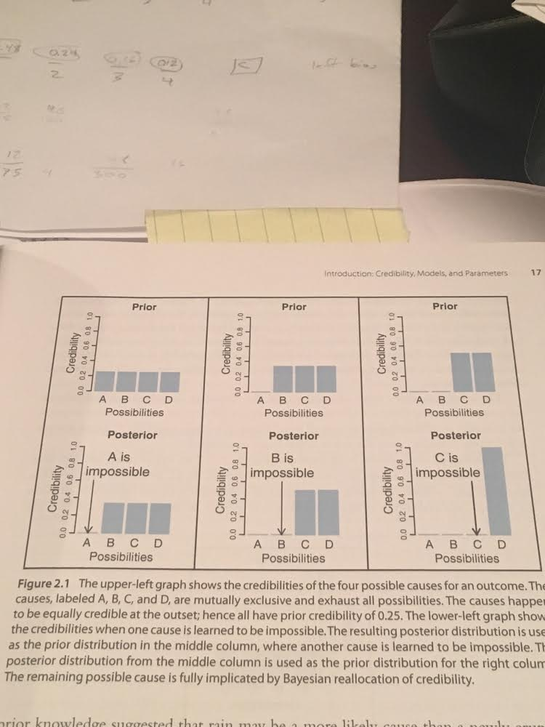
Inference As Credibility Reallocation
Sherlock Holmes uses Bayesian inference!
“When you have eliminated the impossible, whatever remains, however implausible, must be the truth”

Slide 4
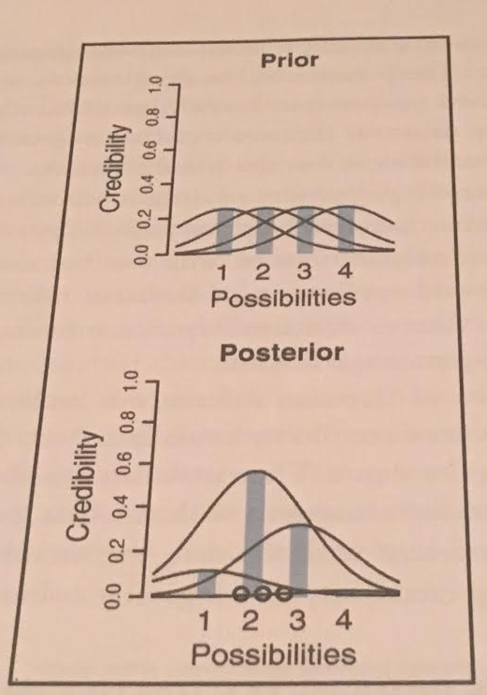
Probabilistic Inference
Four factories which make balls with diameter varying according to normal distribution.
Balls with diameter (μ, 𝞂) = (1in, 1in)
Balls with diameter (μ, 𝞂) = (2in, 1in)
Balls with diameter (μ, 𝞂) = (3in, 1in)
Balls with diameter (μ, 𝞂) = (4in, 1in)
We receive three balls. 1.77, 2.23, 2.70.
Which factory sent that balls?
After updating the evidence, Prob(Factory2) = 0.6

Slide 5
Updating Based On Evidence
Posterior
Posterior
Posterior
Bayesian reasoning uses new evidence to move from prior to posterior.
This is called updating.
Prior
Prior
Prior
H0
H1
H2
H3
E1
E2
E3
Yesterday’s posterior becomes today’s prior.
Bayes
Bayes
Bayes

Slide 6
Plausibility as a Habit of Thought

Slide 7
Plausibility vs Truth
95% confidence we will hit quota in Q3.
We will hit quota in Q3.
Most people process the world using the lens of truth value.
But we can also assess propositions in terms of degree of certainty.
These are distinct modes of reasoning.
Belief
With thresholding, you can recover belief from plausibility.
Disbelief
What if you practiced using plausibility more, in everyday life?
Probability Mass for X
Threshold
Belief in X

Slide 8
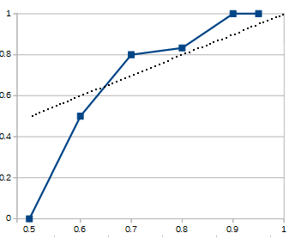
Calibration Example
The act of mentally generating subjective plausibilities is a skill.
With calibration, you can refine it.
2015 World Events - Example Predictions:
U.S. will not get involved in any new major war with death toll of > 100 US soldiers: 70%
Ebola will kill fewer people in 2nd half of 2015 than 1st half: 95%
Assad will remain President of Syria: 70%
US unemployment (U3) will be less than 7% in Dec 2015: 95%
Oil will end the year greater than $60 a barrel: 50%
The dotted line represents perfect calibration; the closer my blue line comes to that, the better I’m doing.
Overall Results:
Of items I marked as 50% confident, 0 were right and 3 were wrong
Of items I marked as 70% confident, 4 were right and 1 was wrong
Of items I marked as 95% confident, 7 were right and 0 were wrong

Slide 9
Benefits of Developing a “Plausibility Habit”
1. Plausibility calculus is more detailed than deductive logic.
2. It more easily accommodates real-world uncertainty.
3. It promotes of changing beliefs based on new evidence
Even when it hurts! This helps combat motivated reasoning.
4. It gives visibility into intuitions that otherwise would remain below the surface.

Slide 10
2.2) Possibilities Are Parameter Values In Descriptive Models

Slide 11
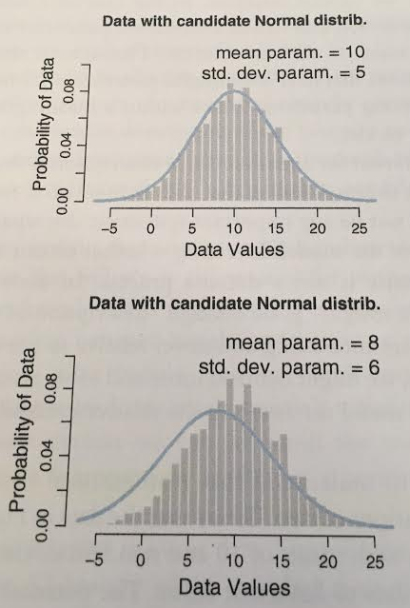
Interpreting Models & Parameters
Models can be thought of as:
mathematical devices that simulate data generation.
Parameters can be thought of as:
control knobs which adjust the behavior of models.
The normal distribution has two parameters:
mean and standard deviation.
Here, we adjust these knobs until they fit the data.

Slide 12
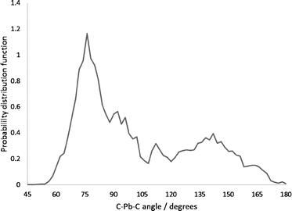
Different Kinds of Possibility Distributions
PMF
PDF
Probability Mass Function (PMF)
Probability Density Function (PDF)
1/6
1
2
3
4
5
6
Snowfall (inches)
DiceRoll
Let DiceRoll be a discrete random variable. Its domain is { 1, 2, 3, 4, 5, 6 }.
If the dice is fair, the PMF of DiceRoll is defined uniformly, as above.
Let Snowfall be a continuous random variable. Its domain [0, ∞)
Imagine the PDF is defined by the above curve.

Slide 13
Exercise Solutions

Slide 14
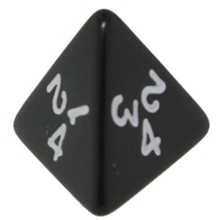
Exercise 2.1
0.25
0.25
0.25
0.25
Model A
Side 1
Side 2
Side 3
Side 4
0.4
0.3
Model B
0.2
0.1
Side 1
Side 2
Side 3
Side 4
Consider a 4-sided die.
What are the chances it will land on a given side?
0.48
0.24
Model C
0.16
0.12
Side 1
Side 2
Side 3
Side 4

Slide 15
Exercise 2.2
Model A
1
2
3
4
Model B
Prior
1
2
3
4
ModelA
ModelB
ModelC
Pr(Hypothesis)
Model C
A) Observe
[25, 25, 25, 25]
B) Observe
[48, 24, 16, 12]
1
2
3
4
Posterior
ModelA
ModelB
ModelC
ModelA
ModelB
ModelC
P(Hypothesis|Data=A)
P(Hypothesis|Data=B)

Slide 16
2.3) The Steps of Bayesian Data Analysis

Slide 17
Bayesian Data Analysis - Steps
1. Identify relevant data
2. Define a descriptive model for the data.
3. Specify a prior distribution for that model’s parameters.
Could Tableau support this?
4. Use Bayesian inference to update credibility across parameter values.
5. Verify posterior distribution mimic the data reasonably well.
If not, consider a different descriptive model.

Slide 18
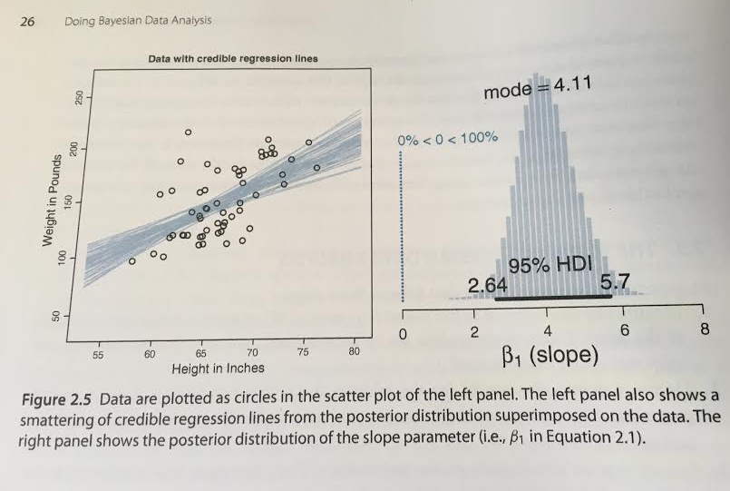
Example: Choosing a model
Linear Regression (“Trend Line”) Model
ŷ = β₁x + β₀
y ~ normal(ŷ, σ)
Three Parameters
The y-intercept, β₀
The slope, β₁
The stddev of the “noise”, σ
Notice how we are distributing probability mass across more than one parameter.
The distribution over β₀ is not shown.

Slide 19
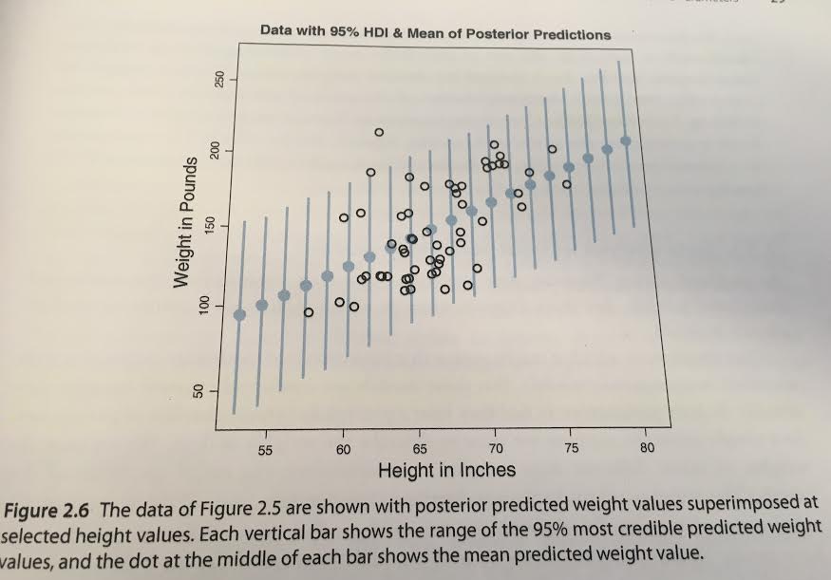
Posterior predictive check

