Slide 1
Probability Theory

Slide 2
Elements & Axioms

Slide 3
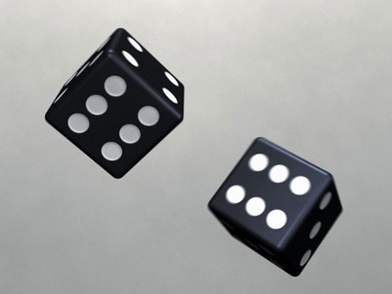
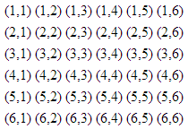
Probability Space of Two Die
Sample Space (Ω)
σ-Algebra (ℱ)
Probability Measure Function (P)
[...]
E5={(1,4),(2,3),(3,2),(4,1)}
[...]
P
E5
0.11

Slide 4
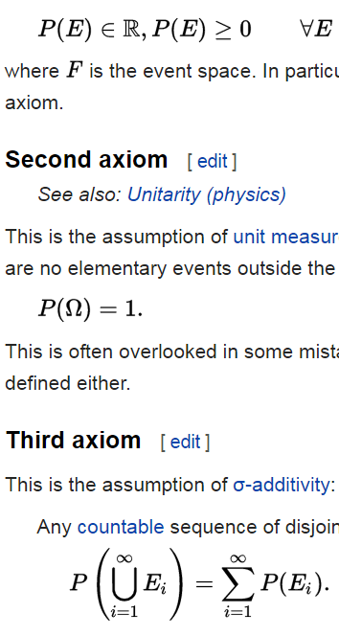
Probability Theory
Probability Space (Ω, ℱ, P)
Probability Axioms
Sample Space (Ω)
1. Non-negativity
(1,1) (1,2) [...]
σ-Algebra (ℱ)
2. Unit Measure (i.e., unitarity)
E5={(1,4),(2,3),(3,2),(4,1)} [...]
Probability Measure Function (P)
3. σ-Additivity
E5
P
0.11
E.g.: P(3dots or 4dots) = P(3dots) + P(4dots) = ⅙ + ⅙ = ⅓

Slide 5
Exercise 4.3) Probability Example
In a pinochle deck, there are 48 cards:
6 values (9, 10, Jack, Queen, King, Ace) x 4 suits x 2 copies = 48
What is the probability of drawing a 10?
What is the probability of drawing { 10 or Jack }?
Recall: σ-Additivity

Slide 6
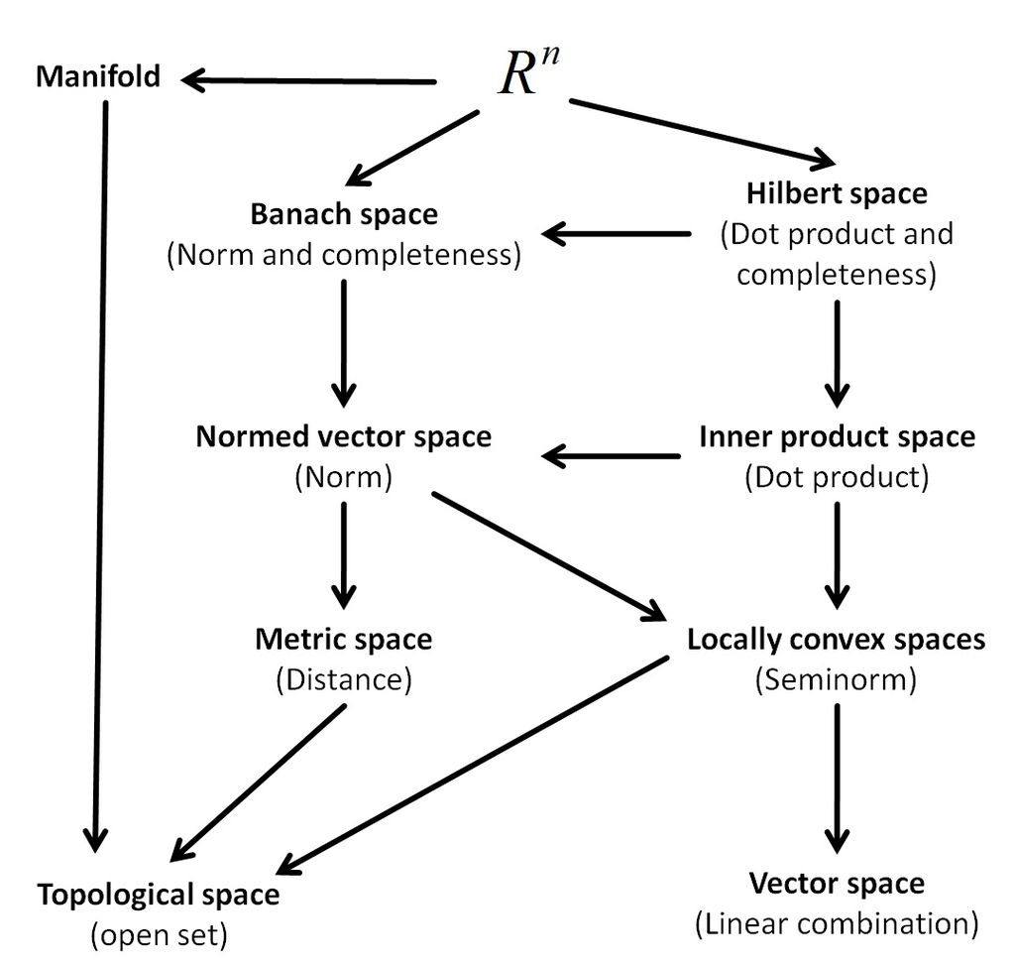
Probability Space vs Other Spaces
If you remove the unitarity axiom, probability space is a measure space.
If you remove the measure function, you are left with a topological space.
In fact, probability space is just a specific resident of the “space of mathematical spaces”.
Why don’t we use e.g., Banach spaces instead?
Prob space
(Unit Measure)
Elements
Axioms
1. Sample Space (Ω)
1. Non-negativity
2. σ-Algebra (ℱ)
2. Unitarity
3. Probability Function (P)
3. σ-Additivity

Slide 7
Plausibility Inference or Frequency Analysis?
Bayes
Probability Theory
Frequentist
Perspective
Requirements For A
Frequency Analysis
System
Kolmogorov Axioms/Theorems
Cox’s Theorem
Requirements For A
Plausibility Inference System
Bayesian
Perspective
Plausibility Axioms

Slide 8
Frequentism vs Bayesianism

Slide 9
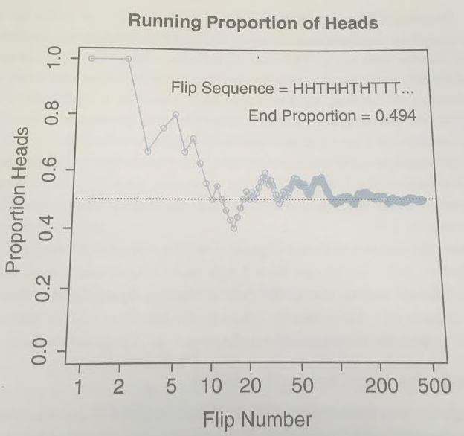
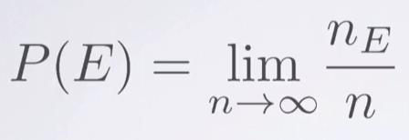
Externalism: Probability as Frequency

Slide 10
Internalism: Probability as Degree of Belief
As we saw, calibration can improve credibility estimates in the long term.
Simulated betting is a way to elicit (materialize) your subjective credibilities.
Proposition X ≝ “A snowstorm will close highway near Indianapolis on Christmas”
Decision 1
Gamble A: You get $100 if X is true
Gamble B: You get $100 if you draw red from a bag with { 5 red, 5 white } marbles.
Decision 2
Gamble A: You get $100 if X is true
Gamble B: You get $100 if you draw red from a bag with { 1 red, 9 white } marbles.
Suppose you prefer Gamble B. This means your subjective P(X) < 0.5.
Suppose you pick Gamble A. This means your subjective P(X) > 0.1.

Slide 11
Probability Distributions

Slide 12
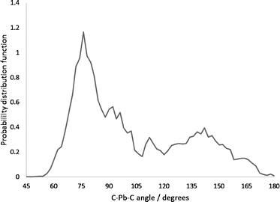
Recall: Two Kinds of Distribution
PMF
PDF
Probability Mass Function (PMF)
Probability Density Function (PDF)
1/6
1
2
3
4
5
6
Snowfall (inches)
DiceRoll
DiceRoll has discrete domain: { 1, 2, 3, 4, 5, 6 }.
Unitarity means: ∑X_{e} = 1
It is also true that: ∀X_{e}, Prob(X_{e}) < 1
Snowfall has continuous domain [0, ∞)
Unitarity means: ∫ p(x) dx = 1
It is not true that: ∀dx, p(x) < 1

Slide 13
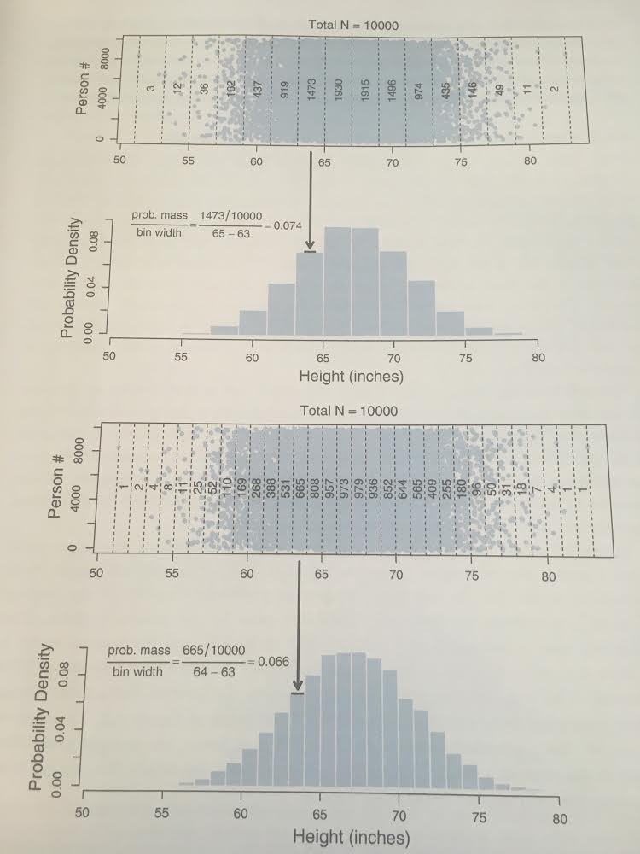
Continuous Bins
Bin Size = 2in
Bin Size = 1in

Slide 14
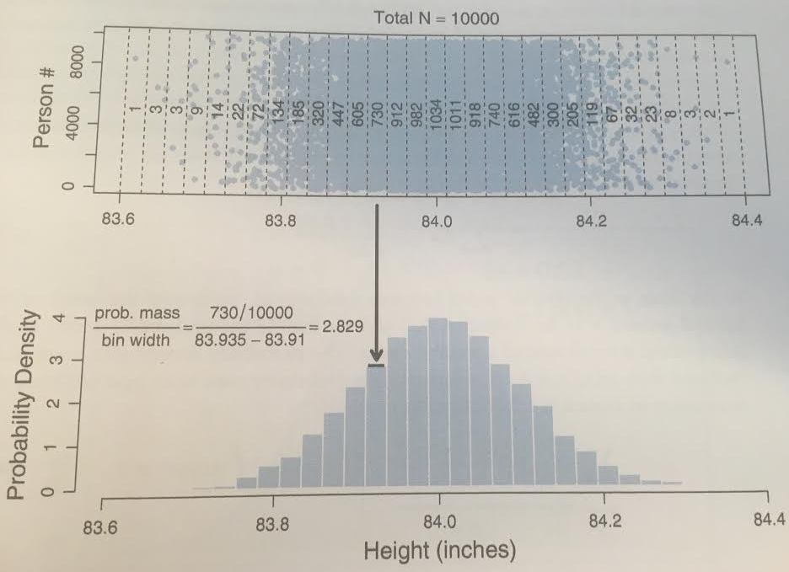
Example of p(x) > 1.0
As bin size becomes infinitesimally narrow, Prob(X) approaches zero. But the ratio of probability mass to interval width is meaningful to talk about.
Let p(x) ≝ Prob(X) / dx
A milligram of metal lead has a density of
~ 11 grams/cm³
This is possible because a milligram of lead takes up 0.000088 cm³ of space.
In the same way, if probability mass is compressed into a very small area, p(x) can exceed 1.0, without violating unitarity.

Slide 15
Unitarity: Discrete vs Continuous
We can algebraically manipulate the discrete unitarity formula, and arrive at the continuous unitarity formula.
∑ Prob([xi, xi + Δx]) = 1
Multiplying Δx / Δx doesn’t change the formulae.
As Δx → 0, we rename each term.
∑ Δx * Prob([xi, xi + Δx]) / Δx = 1
Note: p(x) ≠ Prob(x)
∫
dx
p(x)
This is how we move PMF → PDF
∑Prob(X_{e}) = 1 → ∫ dx p(x) = 1

Slide 16
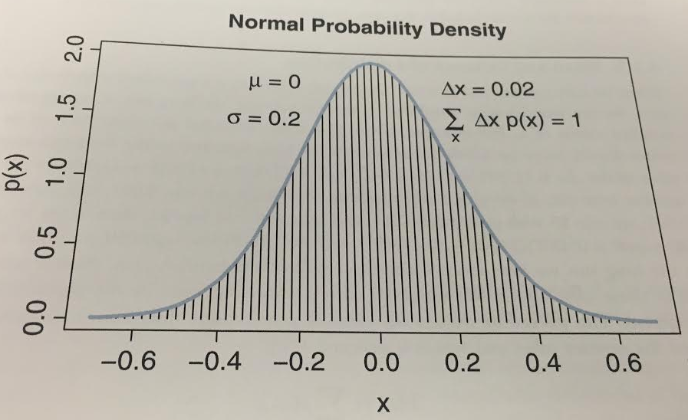
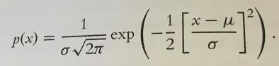
Density for normal distributions

Slide 17
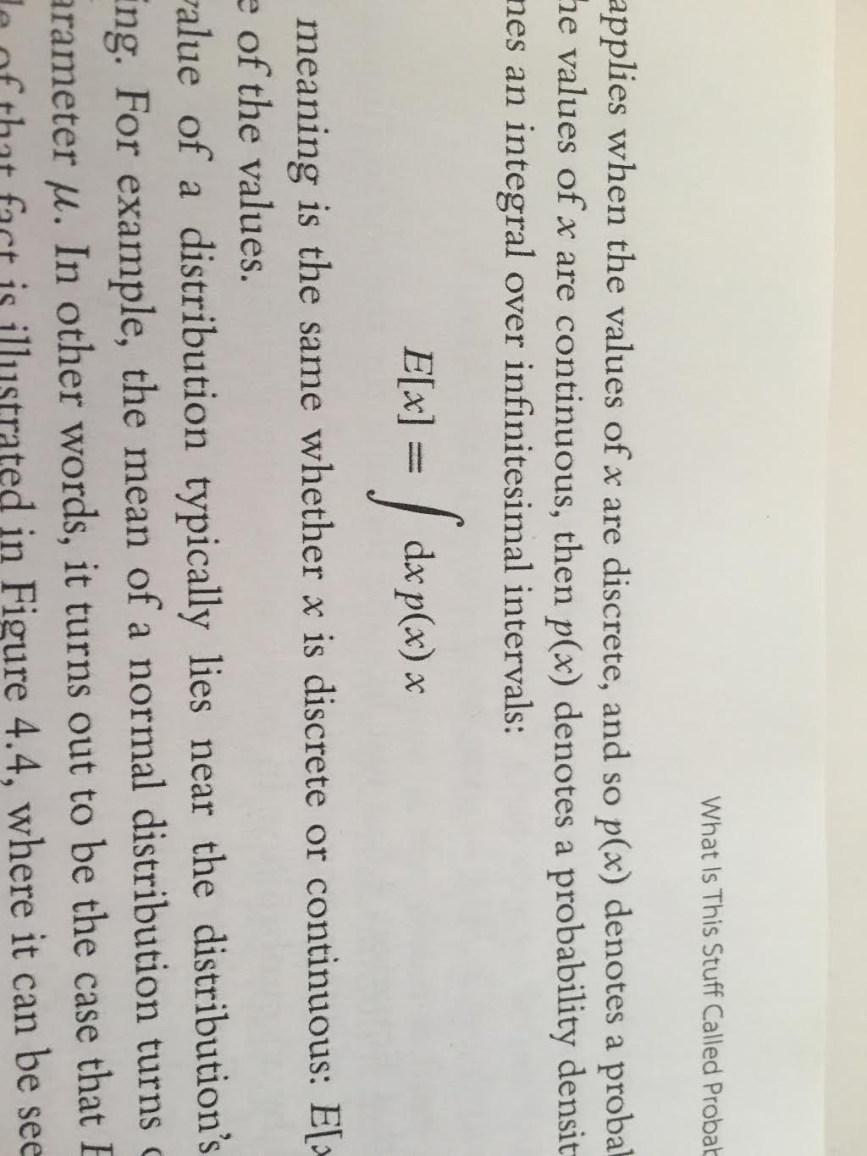
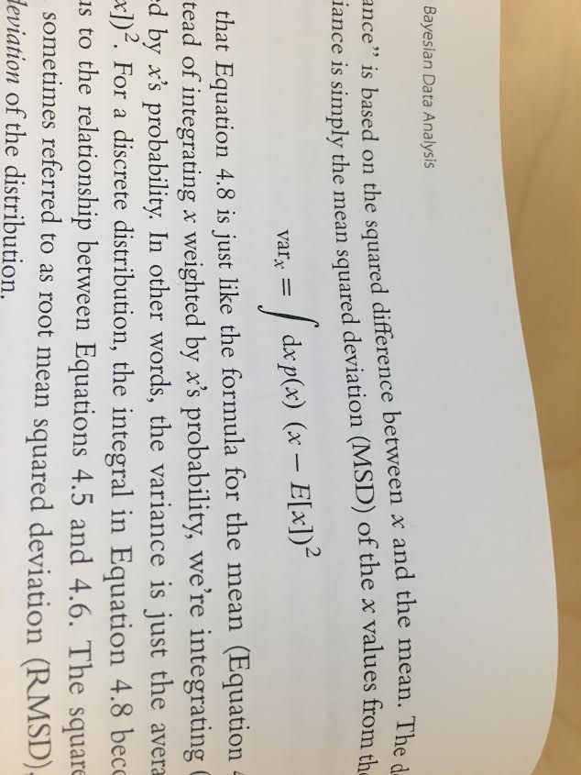
Descriptive Statistics
Central Tendency: mean, median, mode, etc.
Uncertainty: stdev, etc
Question: what is the relation between μ and E[x]?
Expectation Operator is,
Variance is,
Suppose I asked you to compute min(var_{x}). What is the solution?
E[x]. In this sense, mean pairs with stdev.
If we were trying to minimize (x - M), the median would minimize the expected distance.

Slide 18
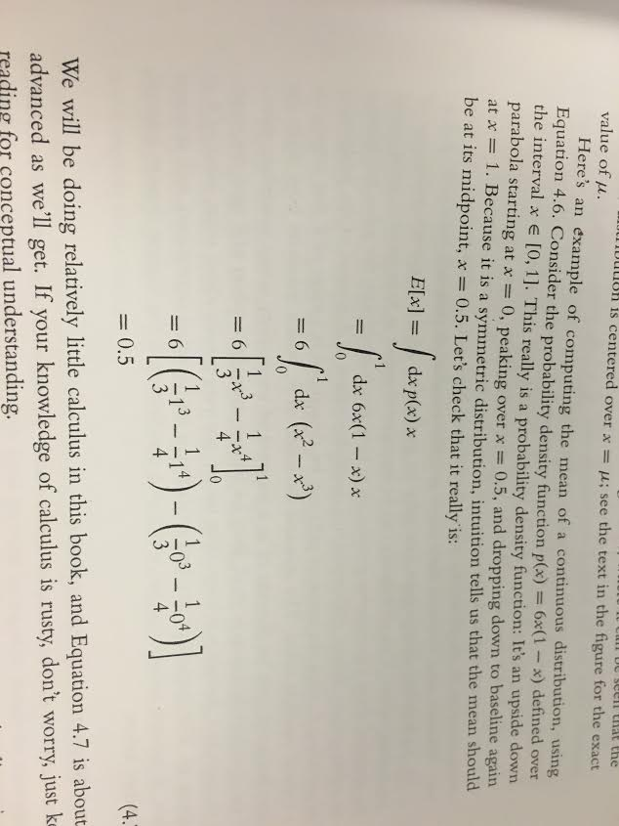
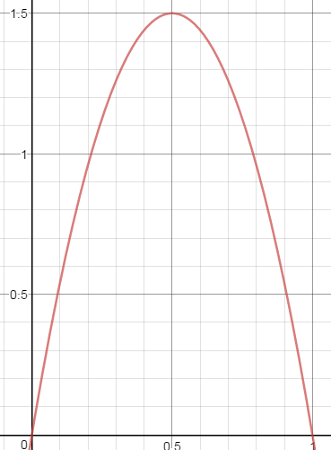
Exercise 4.4
Example
Let p(x) = 6x*(1-x) for x ∈ [0,1]
Let’s run through an example probability density, and calculate E[x]
Recall,
Let’s check our work...

Slide 19
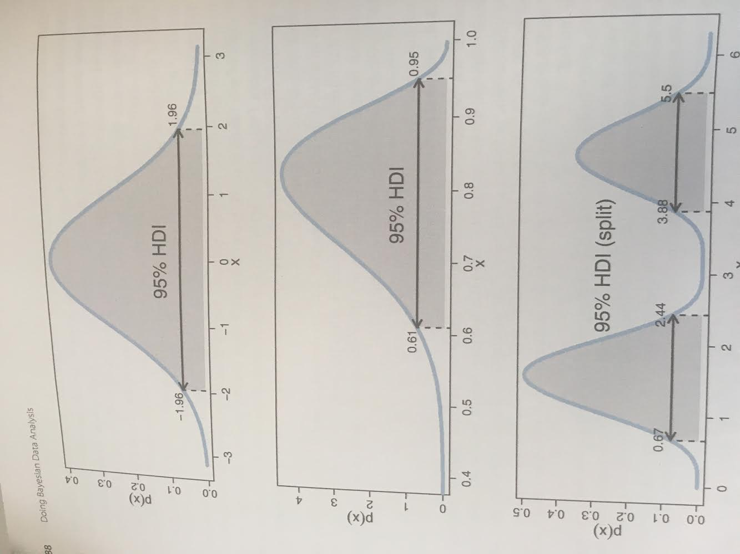
High Density Interval
Another way to summarize a distribution, will be to use High Density Intervals (HDIs). We will use HDIs most often.
Unitarity: For all x, ∫ dx p(x) = 1.00
HDI: Range(s) of x, ∫ dx p(x) = 0.95
Example Distributions:
1. Normal
2. Skewed
3. Bimodal

Slide 20
Two-Way Distributions

Slide 21
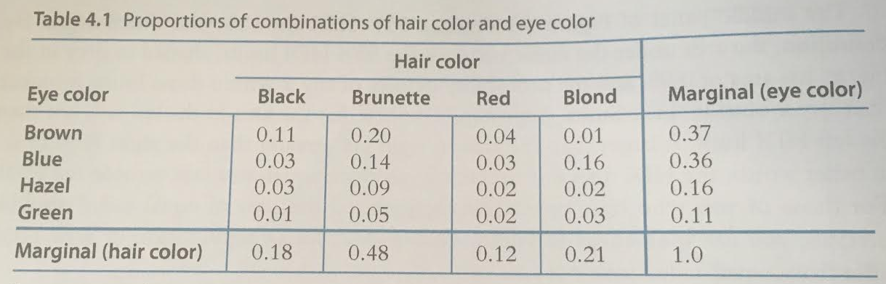
Joint & Marginal Probabilities
Consider two discrete random variables: hair and eye color.
We can distribute probabilities across multiple variables simultaneously.
Each cell in this table (e.g., Prob(Black Hair, Green Eyes)) is a joint probability.
If we collapse a dimension (e.g., row totals), we have marginal probabilities.

Slide 22
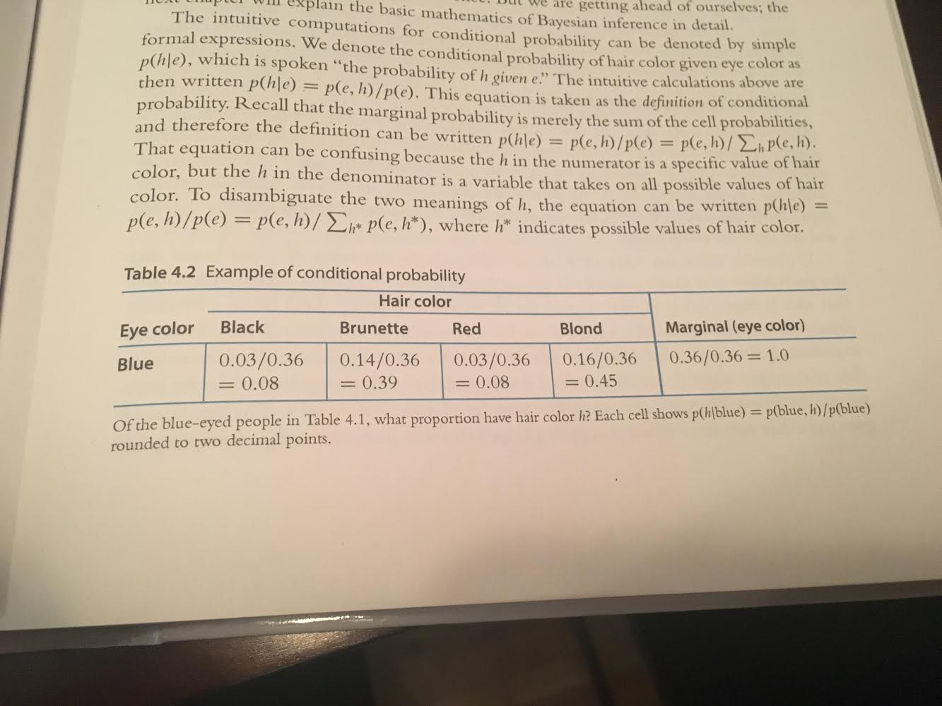
Conditional Probabilities
To condition on blue eyes, you simply filter out other outcomes.
Prob(h|blue) is pronounced “hair color given blue eyes”
Filtering violates unitarity.
After you condition on other outcomes, renormalize

Slide 23
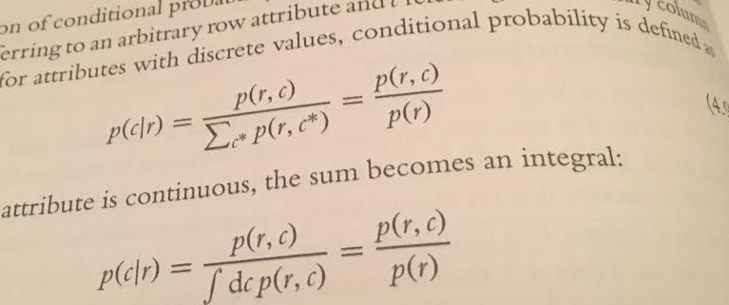
Conditional Probabilities: Formal Definition
Conditionals use normalization.
Each cell here is:
p(h|blue) = p(blue, h) / p(blue)
This normalization process generalizes. Conditional probabilities can be defined as:
Next week, we will use this definition to derive Bayes Theorem.

Slide 24
Exercise 4.1) Conditional Probabilities in R
Let’s run through this scenario in R.

