Slide 1
Markov Chain Monte Carlo

Slide 2
Bayesian Inference: Analytic vs MCMC
Bayesian
Inference
Analytic
Methods
Numeric
Methods
Conjugate Priors
Variational Approximation
Metropolis Algorithm
Gibbs
Sampling
Explored in Ch6. Use if:
Conjugate prior is known.
Joint distribution of parameter space is tractable (few continuous parameters)
Explored in Ch7.
Less accurate: use as last resort!
Because many posteriors are intractable: MCMC revolutionized the field.

Slide 3
Numeric Methods: Metropolis

Slide 4
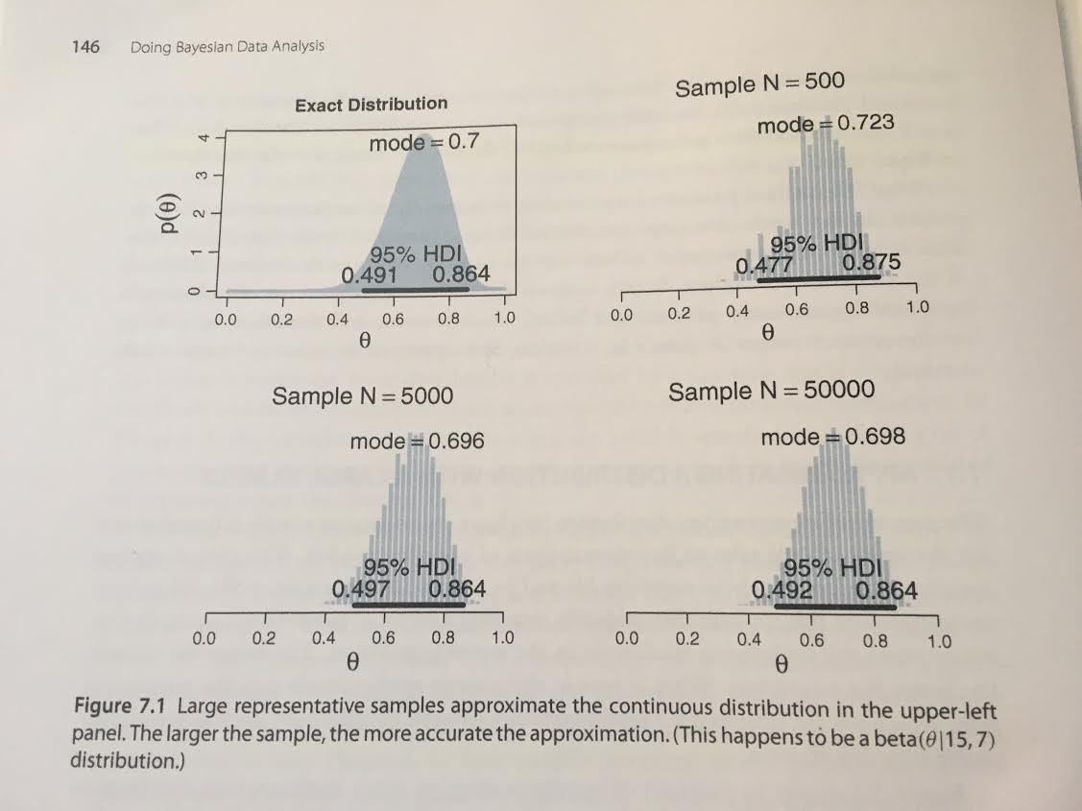
MCMC Overview
If it is impossible to solve the integral, numeric approximations are a good approach.
In practice, only use MCMC when an integral cannot be solved analytically (multiple continuous parameters)
Numerical methods can approximate distributions, by the Law of Large Numbers (LLN).
MCMC approximates a very important distribution: the posterior.

Slide 5
Metropolis Algorithm: Motivation
Scenario:
A politician lives on an island chain.
Wants to spend time on each island, proportional to its population
You cannot learn every island’s populations a priori
  You can only query the populations of neighboring islands
Let’s design an algorithm...

Slide 6
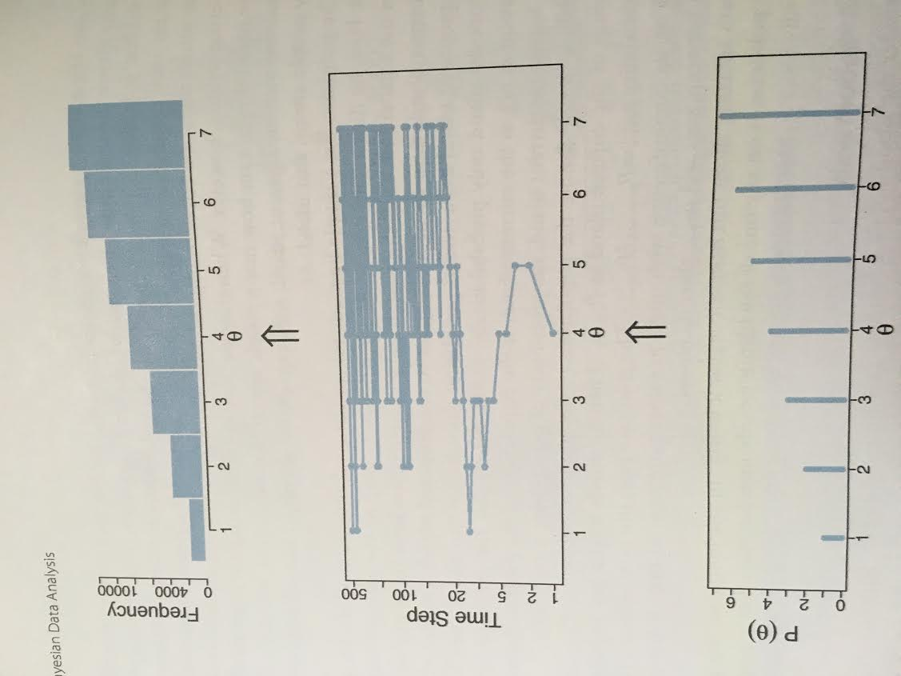
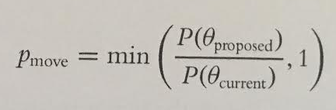
Metropolis Algorithm
Procedure
Generate proposal distribution
  Ex: L vs R
Select proposal candidate
  Ex: flip a coin
Move to candidate by this rule:
Where P = P(D|Θ)*P(Θ); there is no need to compute the integral!
Island Populations
Moves
Visit Frequency

Slide 7
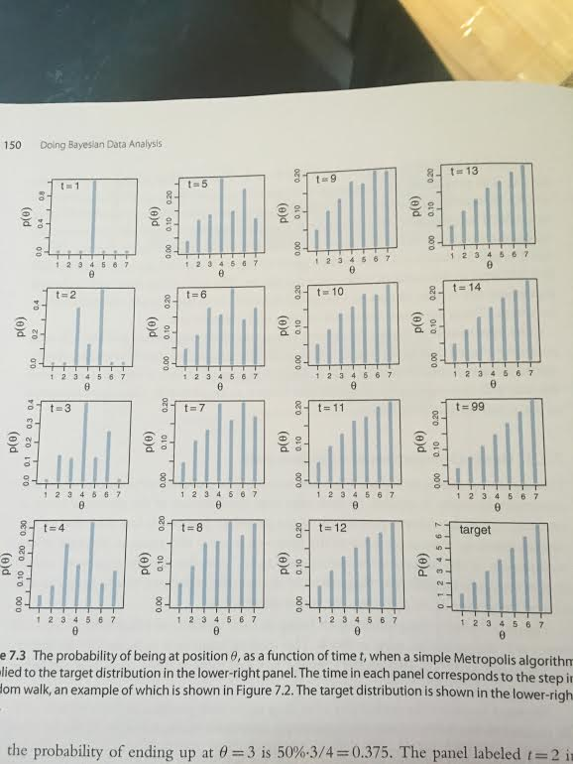
Metropolis: Migrating Location Distribution
That was one case. What can be said for all trial runs?
Consider the probability of the politician’s location.
You can prove that this “goal distribution” is:
Stable: once it is achieved, it will not change.
Unique: there is only one such stable distribution
Achievable: real algorithms arrive at the solution.
In short, the “goal distribution” is an attractor.

Slide 8
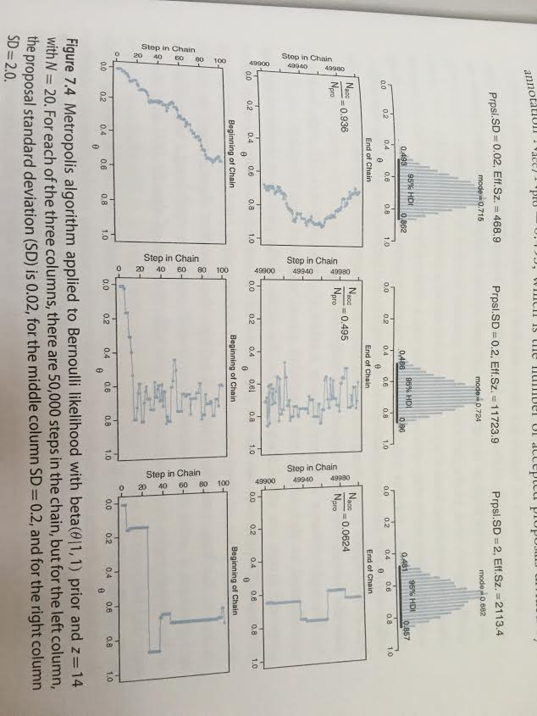
Plausibility Distributions: stddev = Learning Rate
The above example used a discrete parameter (island). Our proposal distribution was just { left, right }.
For continuous parameters, we can use a normal proposal distribution:
Ɲ(μ,σ)
σ will drive the learning rate

Slide 9
Example: Two Coins

Slide 10
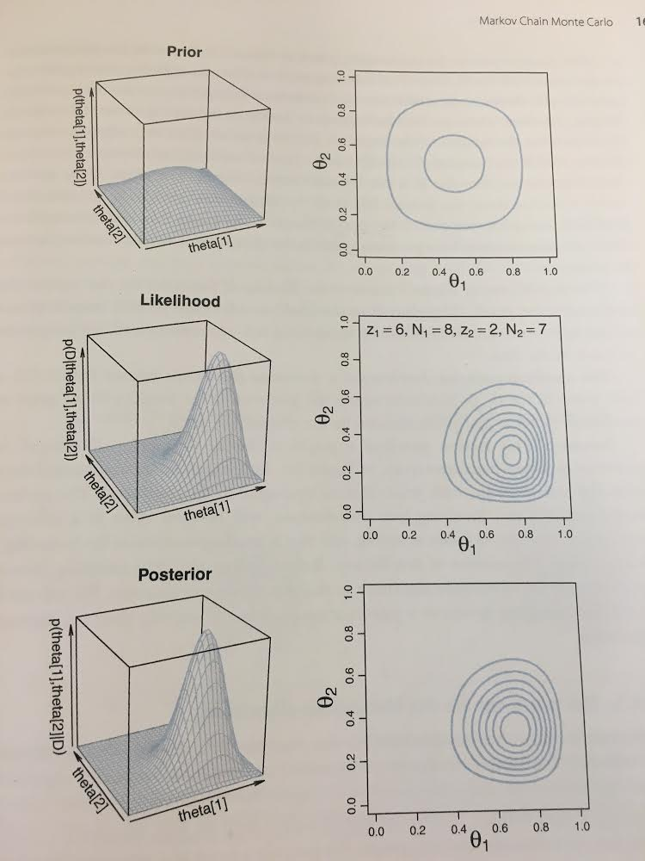
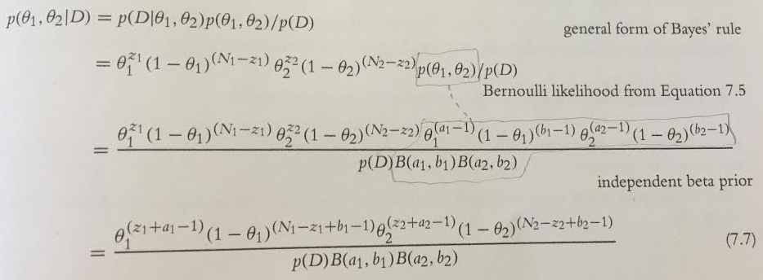
Exact Solution
We must select a conjugate prior.
Beta distributions are conjugate to binomial distributions (product is integrable).
p(Θ₁,Θ₂) = beta(Θ₁|a, b) * beta(Θ₂|a,b)

Slide 11
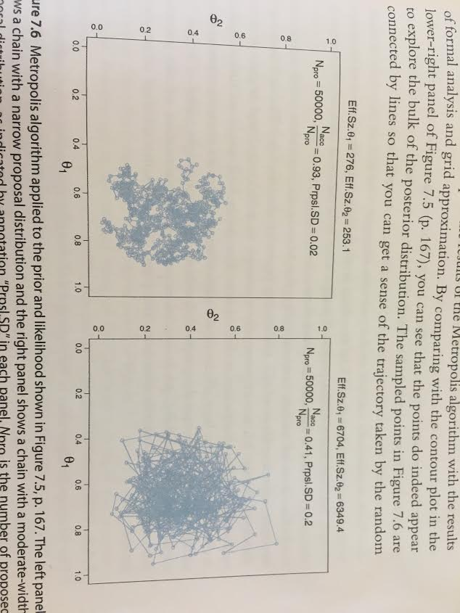
Metropolis Solution
For two parameters, our proposal distribution is a bivariate normal.
If we set σ to 0.02, we get a fractal-looking walk.
With a larger σ, our walk is less clumpy, more efficient.
Effective Size (ESS)
A measure of algorithmic efficiency (defined later).

Slide 12
Gibbs Sampling

Slide 13
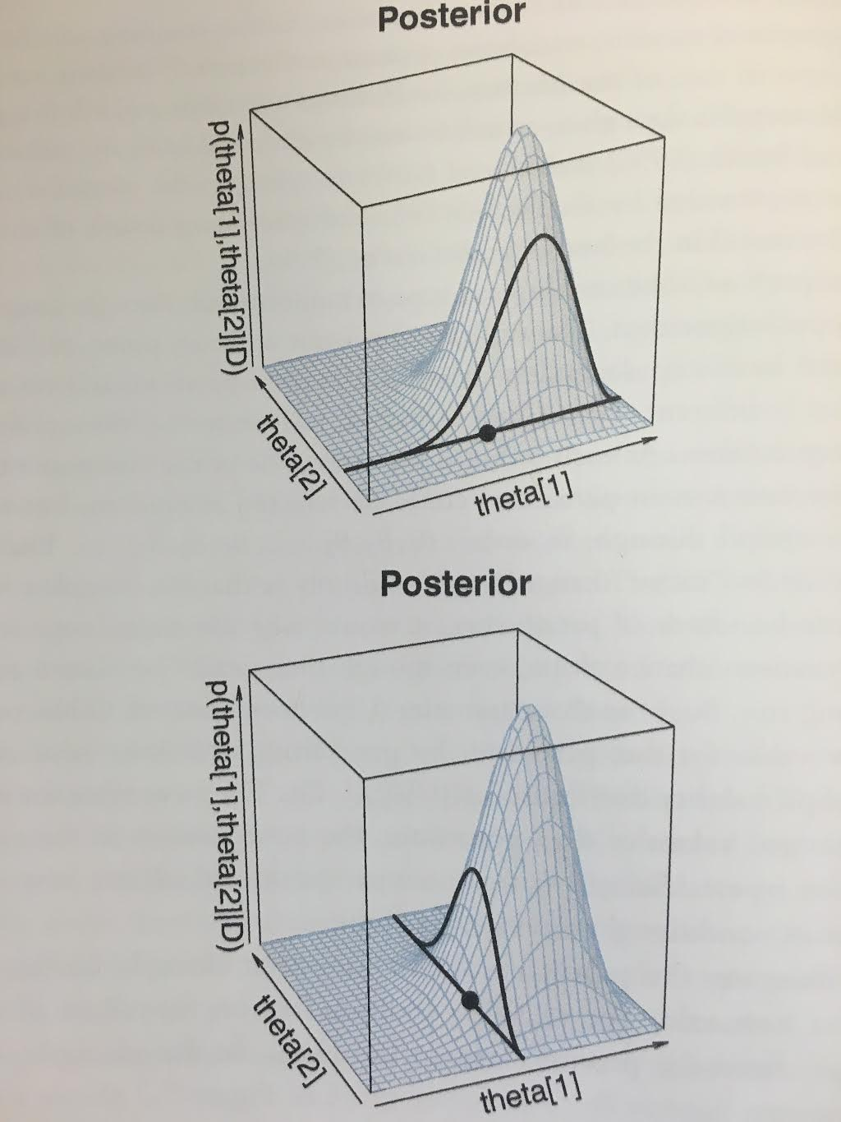
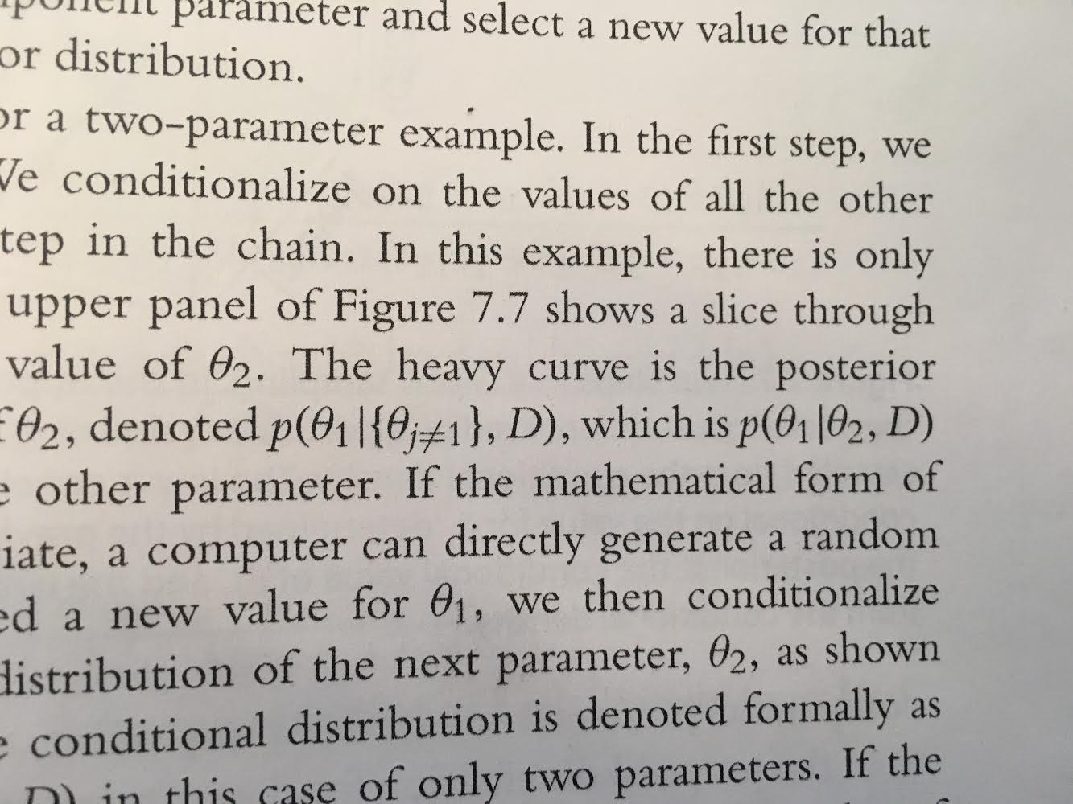
Introducing Gibbs
Metropolis works best if proposal distribution is properly tuned to the posterior.
Gibbs sampling is more efficient, and good for hierarchical models.
In Gibbs, parameters are selected one at a time, and cycled through (Θ₁, Θ₂,...,Θ₁,Θ₂,...)
New proposal distribution:
E.g., with only two parameters
Because the proposal distribution exactly mirrors the posterior for that parameter, the proposed move is always accepted.

Slide 14
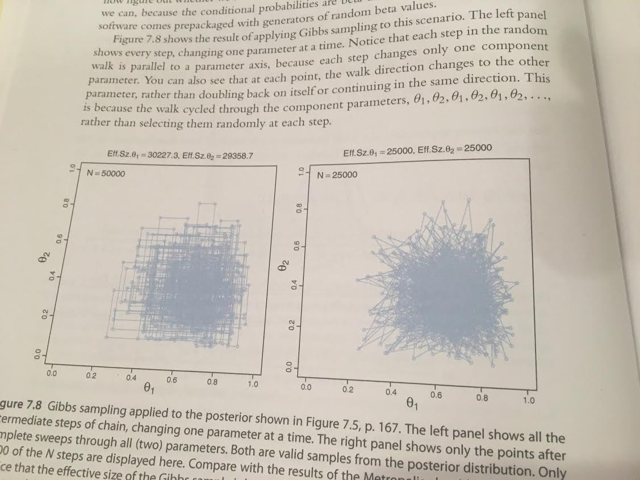
Gibbs Sample: Pros & Cons
Intermediate Steps Shown
Whole Steps Shown
Pros:
No inefficiency of rejected proposals
No need to tune proposal distributions
Cons:
1-D posterior dists must be derivable.
Progress can be stalled by highly correlated parameters.
To motivate the second “con”:
Imagine a long, narrow, diagonal hallway. How does Gibbs differ from Metropolis?

Slide 15
MCMC Diagnostics

Slide 16
The Space of MCMC Algorithms
Monte Carlo: samples random values from a distribution
Inspired by the famous casino locale
Markov Chain: any sequential process where each step has no memory for states before the current one.
We have seen two specific Markov chain Monte Carlo (MCMC) methods
MCMC
Metropolis
Gibbs
Slice
Reversible Jump

Slide 17
MCMC Desiderata
First, output must be representative.
Not unduly influenced by starting value, don’t get “stuck”.
Second, method must be repeatable.
Central tendency & HDI should not be much different if analysis is rerun.
Third, method must be efficient.
Good approximations of the posterior should emerge from minimal resources.

Slide 18
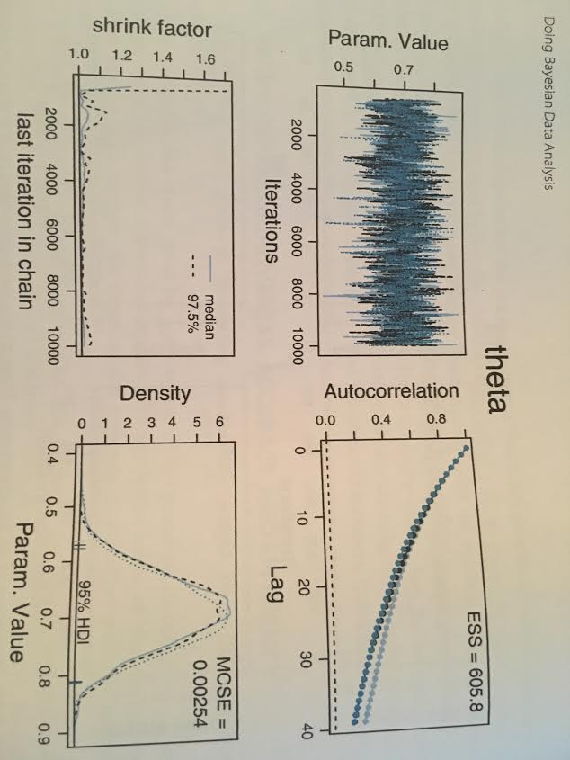
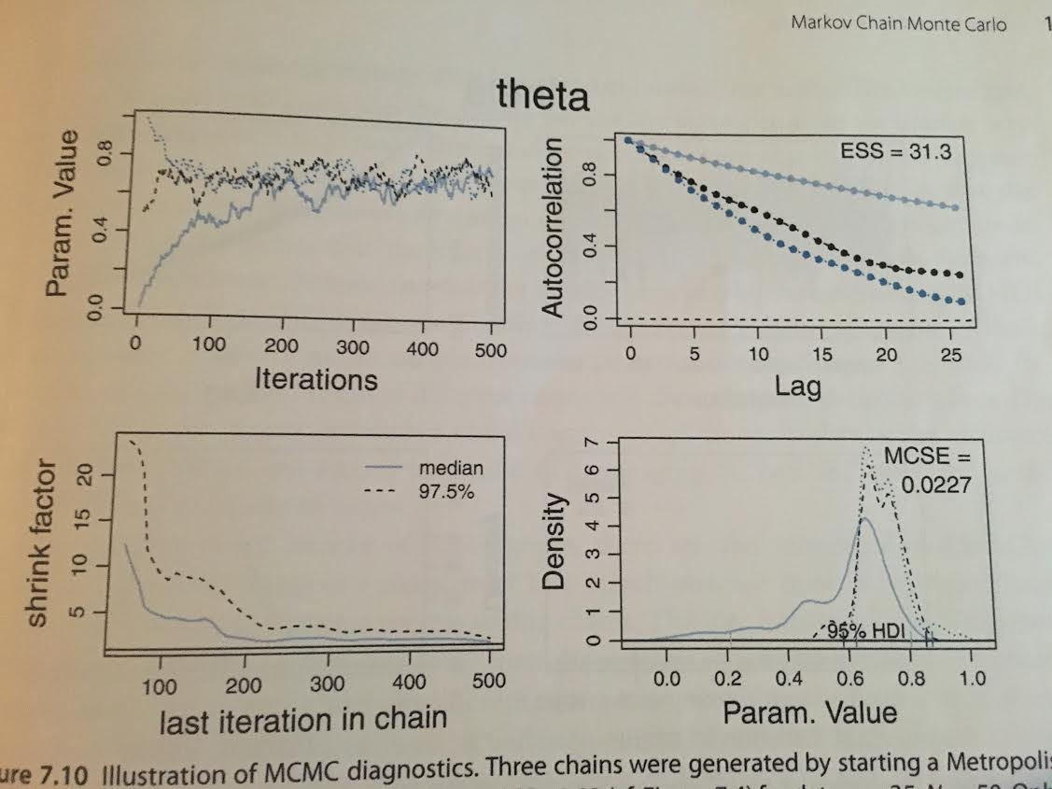
Representative: Density Plots
A density plot averages across overlapping intervals to show probability density.
Here are three density plots for MCMC, run against 3 different starting conditions.
Importantly, if we only consider the first Steps 1-500, we get distorted results
We usually exclude the initial steps from our diagnostics, called the burn-in period.

Slide 19
Representative: Trace Plot
We’ve seen trace plots before. They trace parameter location across time.
Sticking with the same example, here is the trace plot for our 1D parameter
All three runs show similar behavior. The algorithm converges.
As before, the burn-in period should be excluded (irrelevant information).

Slide 20
Representative: Shrink Factor
A measure for convergence is the Gelman-Rubin statistic, i.e., the shrink factor.
This factor explores how between-chain and within-chain distances relate.
If one or more chains gets “stuck”, it will increase the between-chain variance relative to the within-chain variance.
If no chain gets stuck, the shrink factor will converge to 1.0, as in our example.

Slide 21
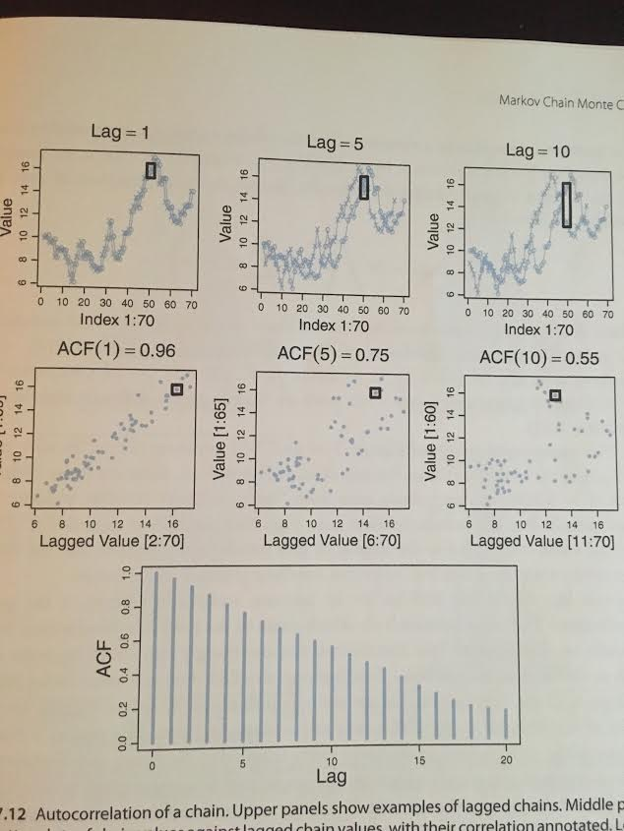
Autocorrelation Tutorial
Some chains are more clumpy than others. Successive steps don’t provide independent information about the parameter distribution.
To measure clumpiness, we use autocorrelation: the correlation of the chain values with the chain values k steps ahead.
Consider ACF(k=10):
For step=50, the chain values are 13 and 16.
This values is converted into a point: (13, 16).
Other value pairs are likewise converted into points.
The correlation of the resultant scatterplot is 0.55
We can likewise compute ACF(1), ACF(5), etc.

Slide 22
Accuracy: Autocorrelation
After excluding the burn-in period, the ACFs of different trials also match one another.
How sharply the curve drops off is a good measure of algorithmic efficiency.

Slide 23
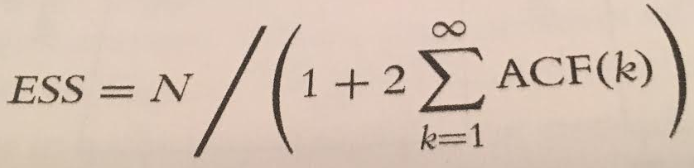
ESS & MCSE
The effective sample size (ESS) shrinks as ACF grows.
Thus, the amount of independent information is captured.
R Command: effectiveSize function in coda pkg
The Monte Carlo Standard Error (MCSE) is an analogue of classical standard error,
SE = SD / √ N.
We simply replace N with ESS!
MCSE = SD / √ESS

Slide 24
The End

