Slide 1
Hierarchical Models

Slide 2
Parameter Dependencies & Factorization
Resident parameters of hierarchical models may depend on one another.
Hierarchical models allow joint probabilities to be factored into chains of dependencies:
p(𝛳₁,𝛳₂,⍵|D) ∝ p(D|𝛳₁,𝛳₂,⍵)p(𝛳₁,𝛳₂,⍵)
Surgical Team
⍵
p(𝛳₁,𝛳₂,⍵|D) ∝ p(D|𝛳₁,𝛳₂,⍵)p(𝛳₁|𝛳_{2,}⍵)p(𝛳₂|⍵)p(⍵)
p(𝛳₁,𝛳₂,⍵|D) ∝ p(D|𝛳₁,𝛳₂,⍵)p(𝛳₁|⍵)p(𝛳₂|⍵)p(⍵)
𝛳₁
𝛳₂
Patient Outcomes
This expresses conditional independence.
If patient 2 has a good model of the surgical team, they don’t learn anything new from patient 1.
Each outcome inform the higher-level parameters, which in turn constrain all individual parameters.

Slide 3
Review: Gibbs Sampling, Beta Dist

Slide 4
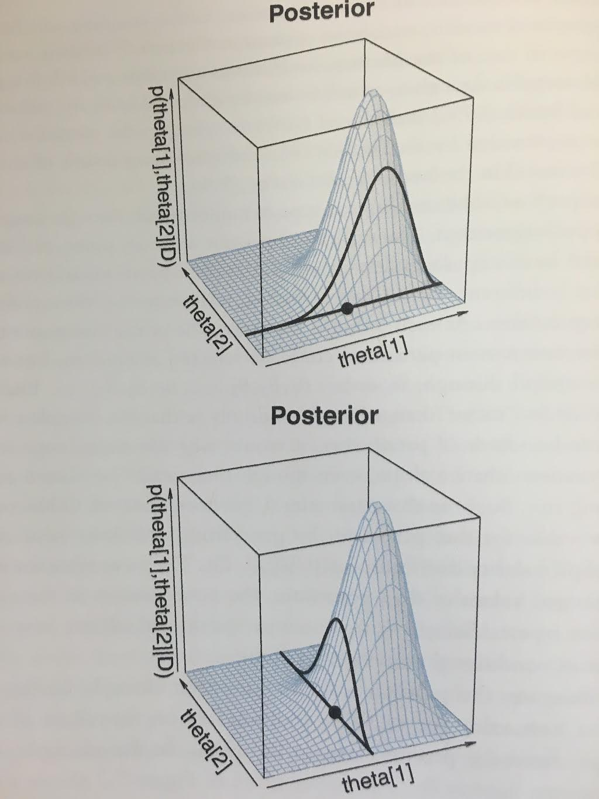
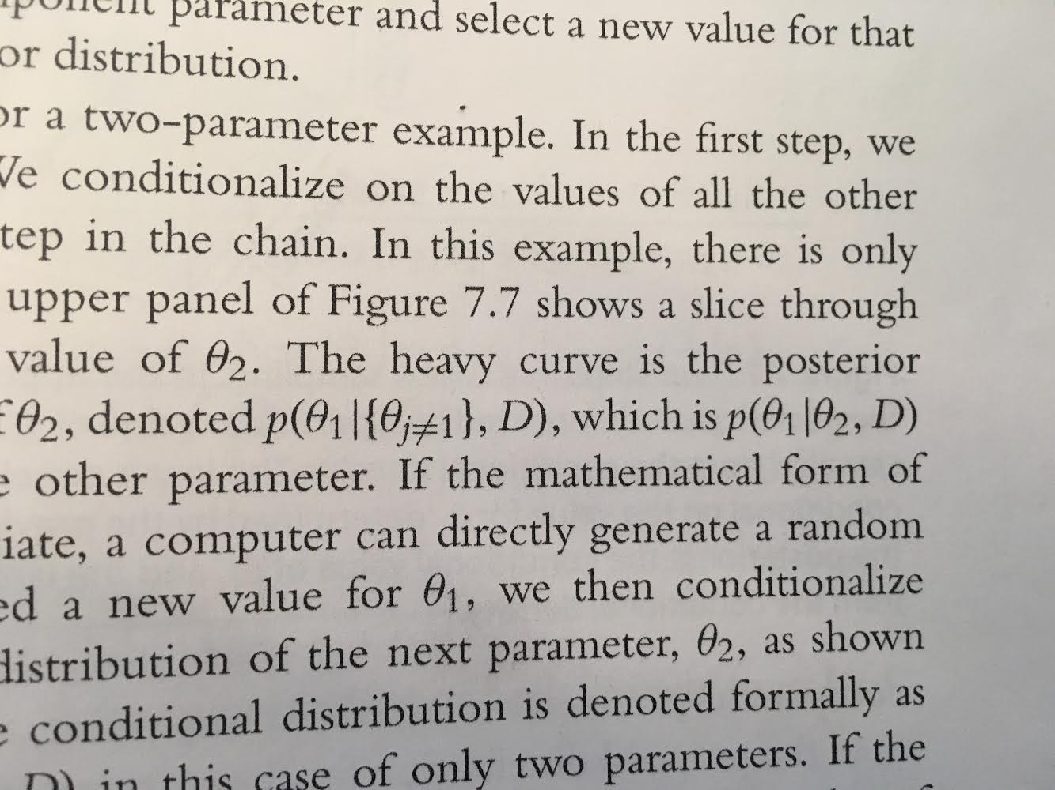
Introducing Gibbs
Metropolis works best if proposal distribution is properly tuned to the posterior.
Gibbs sampling is more efficient, and good for hierarchical models.
In Gibbs, parameters are selected one at a time, and cycled through (Θ₁, Θ₂,...,Θ₁,Θ₂,...)
New proposal distribution:
E.g., with only two parameters
Because the proposal distribution exactly mirrors the posterior for that parameter, the proposed move is always accepted.

Slide 5
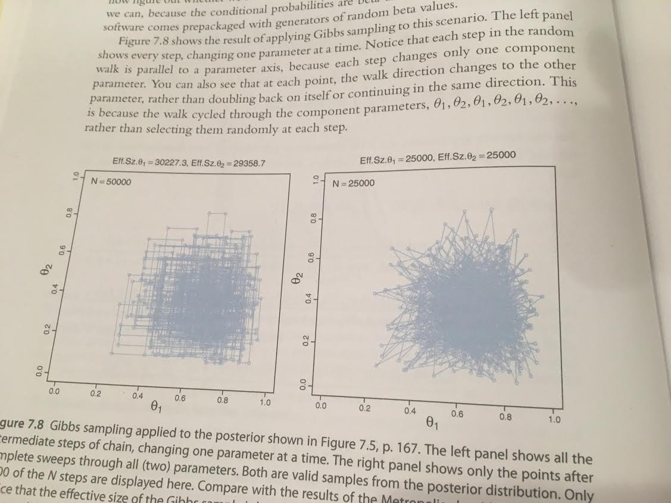

Gibbs Sample: Pros & Cons
Advantages
No inefficiency of rejected proposals.
No need to tune proposal distributions
Intermediate Steps Shown
Whole Steps Shown
Disadvantages
Progress can be stalled by highly correlated parameters.
Imagine a long, narrow, diagonal hallway. How does Gibbs differ from Metropolis?
Posterior distributions must be derivable.
This is much easier with conditional independence. Gibbs sampling pairs well with Hierarchical Models.

Slide 6
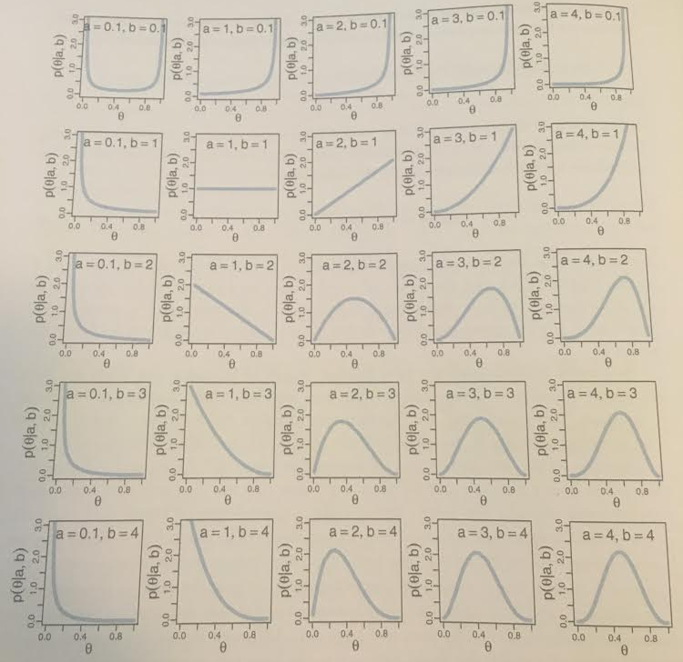
Beta Distribution
⍵ = 30
All distributions have control knobs.
The beta distribution has two: A, B.
⍵ = 2
However, these parameters are not particularly semantically meaningful. Why not re-parameterize?
⍵ = 1.5
⍵ = (a+1)/(a+b-2)
𝛋 = a + b
⍵ = 1
Interpretation of these new parameters is more straightforward:
⍵ is the “mode”
𝛋 is the “concentration”
⍵ = 0.75
Take, for example, our middle column...

Slide 7
One Mint, One Coin

Slide 8

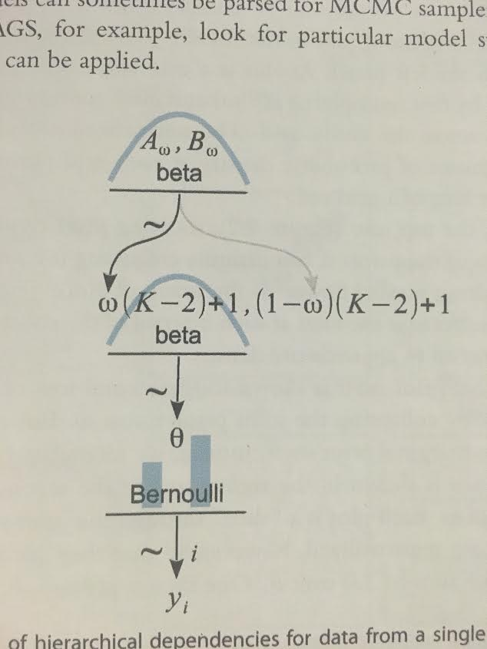


Parameter Chains
Factory params: A, B
Coin outcomes come from the Bernoulli distribution, which has one parameter: 𝛳 (specific bias)
⍵: Average coin bias
Mint factory outputs are viewed beta distribution. Coin biases increase proportional to ⍵
𝛳: Flipping coin bias
Finally, to understand our mint compared to other factories, we draw its ⍵ from another beta dist.
y: Flip Outcomes

Slide 9
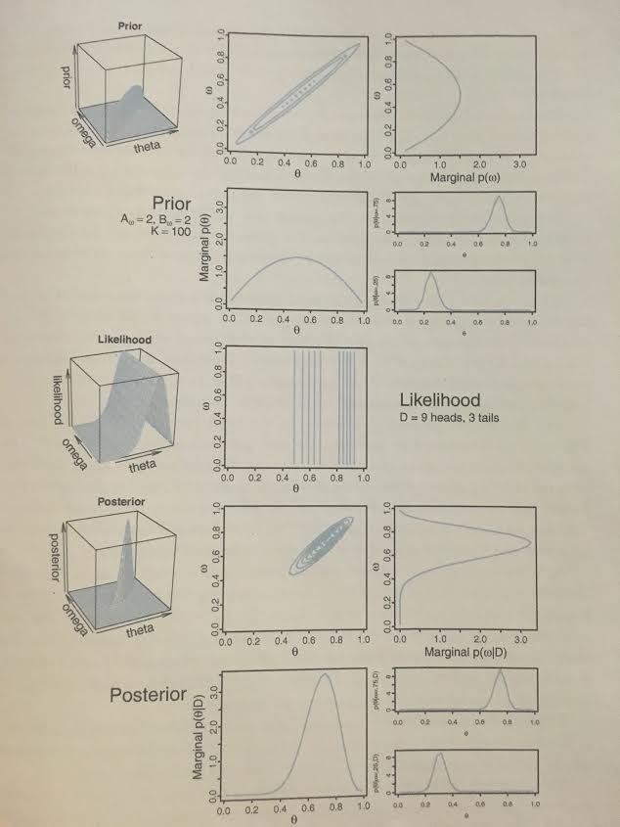
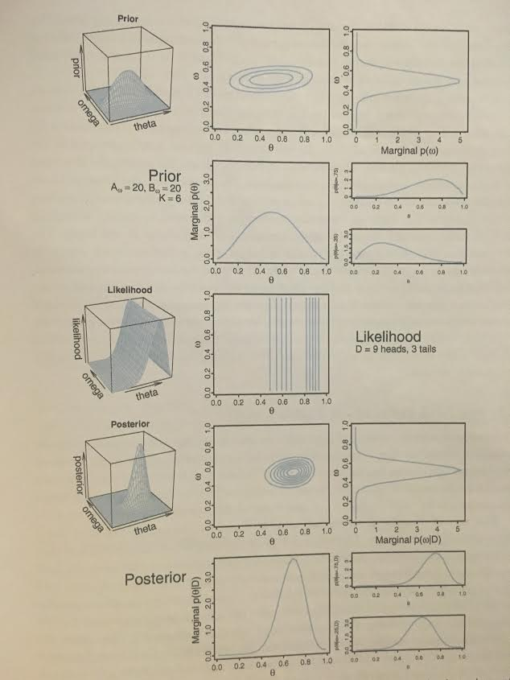
Figure 9.2
Prior
For the prior:
Low certainty regarding ⍵
High certainty regarding dependence of ⍵ on 𝛳.
The likelihood is based on the following data:
D = 9 heads, 3 tails
Question: why is the likelihood invariant to ⍵?
Likelihood
For the posterior:
Distribution of ⍵ has been changed.
Dependence of ⍵ on 𝛳 still persists
Posterior

Slide 10
Figure 9.3
Prior
For the prior:
High certainty regarding ⍵
Low certainty regarding dependence of ⍵ on 𝛳.
The likelihood is the same as before:
D = 9 heads, 3 tails
Likelihood
For the posterior:
High certainty regarding ⍵
Low certainty regarding dependence of ⍵ on 𝛳.
Posterior

Slide 11
The Effect of the Prior
Prior
Likelihood
Posterior

Slide 12
One Mint, Two Coins

Slide 13
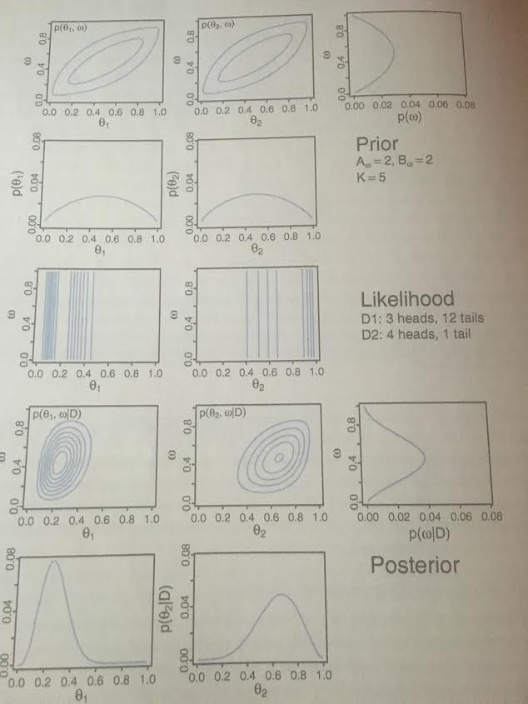
Figure 9.5
Prior
For the prior:
Low certainty regarding ⍵
Low dependence of ⍵ on 𝛳 (K=5)
The likelihood is based on:
D1 = 3 heads, 12 tails
D2 = 4 heads, 1 tail
Q: why are 𝛳₁ contours more dense?
Likelihood
For the posterior:
Distribution of ⍵ has been changed.
Dependence of ⍵ on 𝛳 still persists
Posterior

Slide 14
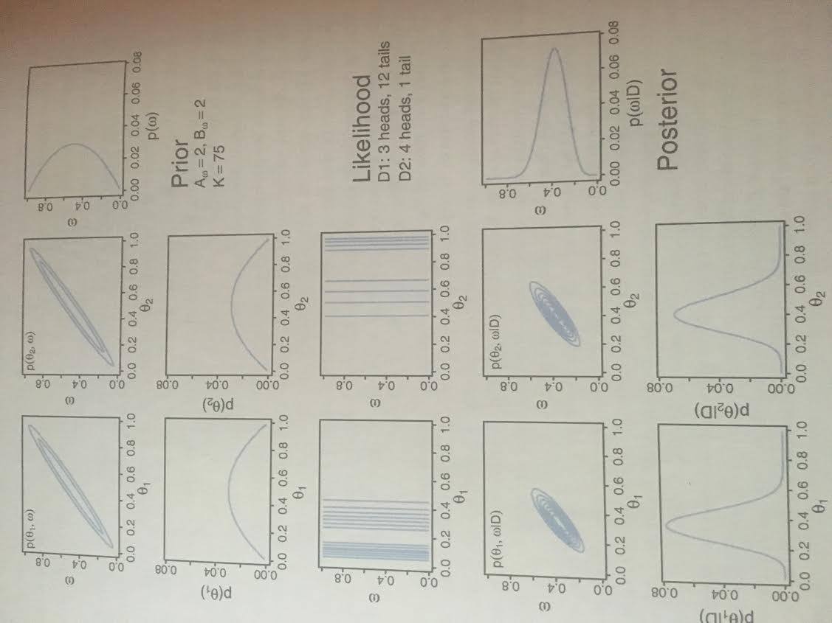
Figure 9.6
Prior
The prior encodes high dependence of ⍵ on 𝛳: K=75. The posterior will “live in this trough”
The likelihood is based on:
D1 = 3 heads, 12 tails
D2 = 4 heads, 1 tail
Likelihood
The posterior 𝛳₂ is peaked around 0.4, far from 0.8 in its coins data! Why?
Other coin has more data- greater effect on ⍵, which in turn influences 𝛳₂
Posterior

Slide 15
One (Realistic) Mint, Two Coins

Slide 16
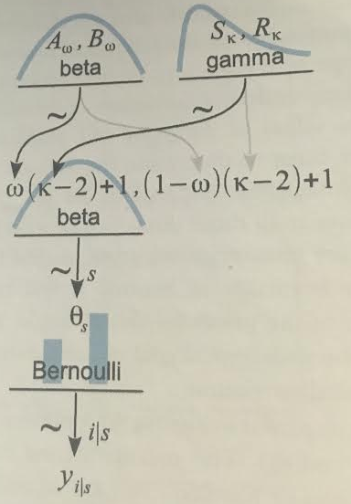
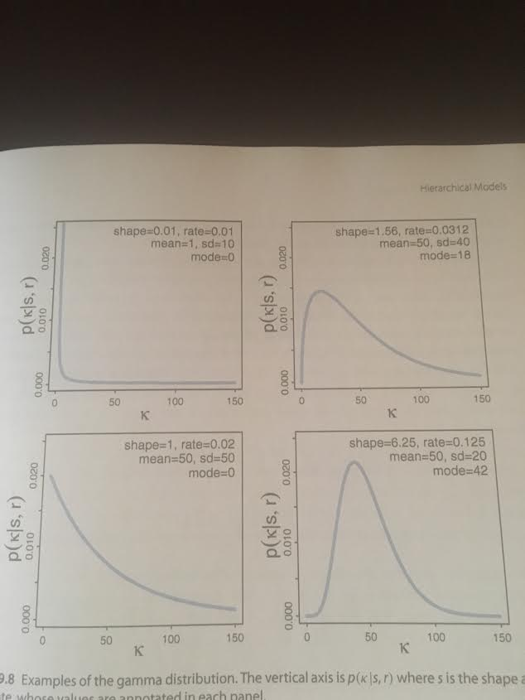
Mint Variance & Gamma
Recall that before, we set beta “distribution width” 𝜅 = K.
Now, let 𝜅 be drawn from a distribution. We want 𝜅 to be small.
Draw 𝜅 from a gamma dist. 2 params: shape and rate (S_{𝜅}, R_{𝜅})
(0.01, 0.01)
(1.56, 0.03)
(1, 0.02)
(6.3, 0.125)

Slide 17
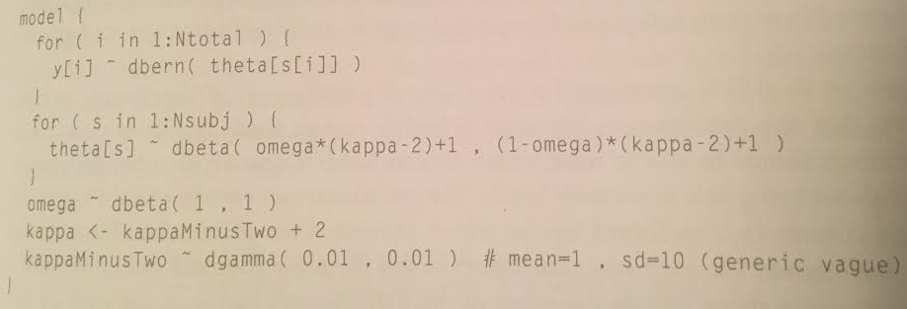
Hierarchical Models, in JAGS

Slide 18
Example: Therapeutic Touch

Slide 19
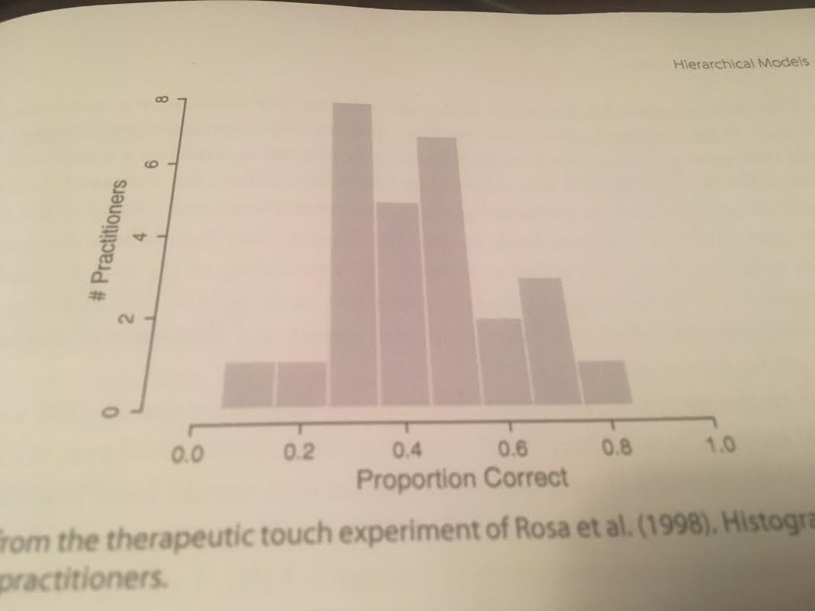
Setup, Data, and Model
Data
General Claim: Therapeutic Touch practitioners can sense a body’s energy field.
Operationalized Claim: They should sense which of their hands is near another person’s hand, with vision obstructed.
Ability & Consistency of Group
Ability of Individual
Practitioners
Hierarchical Model
28 practitioners tested for 10 trials.
Trial
Outcomes
Our “coin” model fits perfectly:

Slide 20
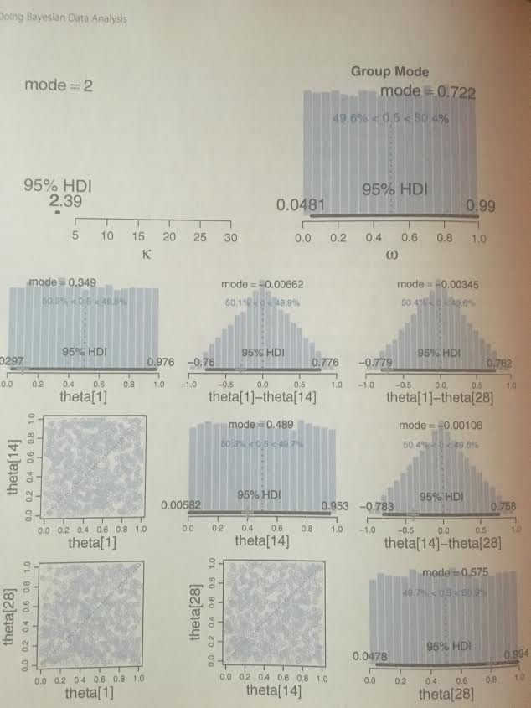
JAGS Prior
We set our priors with low certainty, to avoid biasing the final result.

Slide 21

JAGS Code

Slide 22
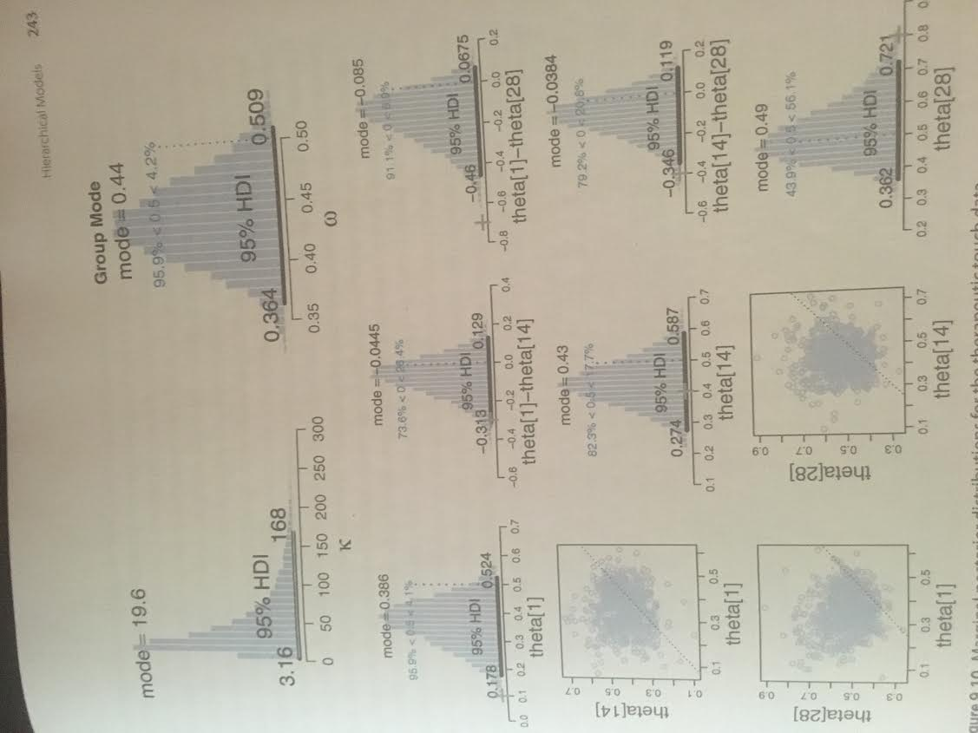
JAGS Results
If the 0.5 ∉ HDI, we might be justified in concluding that bodily presence was detectable.
If max(HDI) < 0.5, it was somehow detected + misinterpreted
The model assumed that all individuals were representative of the same overarching group.
All individuals mutually informed each other’s estimates.

Slide 23
Shrinkage
We have seen low-level parameters trying to reconcile two sources of information:
The data
The higher-level parameter
Non-hierarchical models, in contrast, must only accommodate the former.
This additional constraint, then, makes posterior distributions more narrow, overall.
This is desirable: parameter estimates are less affected by random sampling noise.

Slide 24
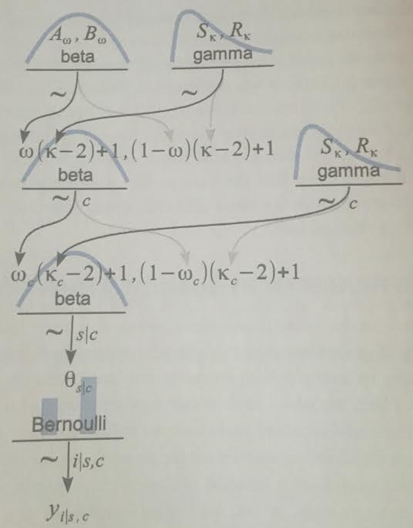
Higher-Level Models
Ability & Consistency of Group
We can easily construct third-order hierarchies.
In baseball, this is important: pitchers have much different batting average from other positions.
Ability & Consistency of Position
Ability of Individual
Players
Neither position- nor positionless- models are uniquely “correct”.
Like all models, parameter estimates are meaningful descriptions only in context of model structure.
Batting
Outcomes

Slide 25
The End

