Slide 1
Bayesian Linear Regression

Slide 2
Introducing GLM
Important Variable Descriptors:
Independent vs Dependent
Cardinal vs Ordinal vs Categorical
GLM
Linear Regression and ANOVA are closely related.
In fact, they are both special cases of a more general family of models:
General Linear Model (GLM)
ANOVA
Linear
Regression
Categorical
Predictor
Variable(s)
Continuous
Predictor
Variable(s)

Slide 3
OLS Linear Regression
Worked Example

Slide 4
Against Causality
If a dependent variable depends on an independent variable, that still doesn’t conclusively demonstrate causality nor temporal priority.
Height can depend on weight, but doesn’t “happen first”
Similarly, even if a linear regression model provides a lot of predictive power, Y might still be causally disconnected from X.

Slide 5
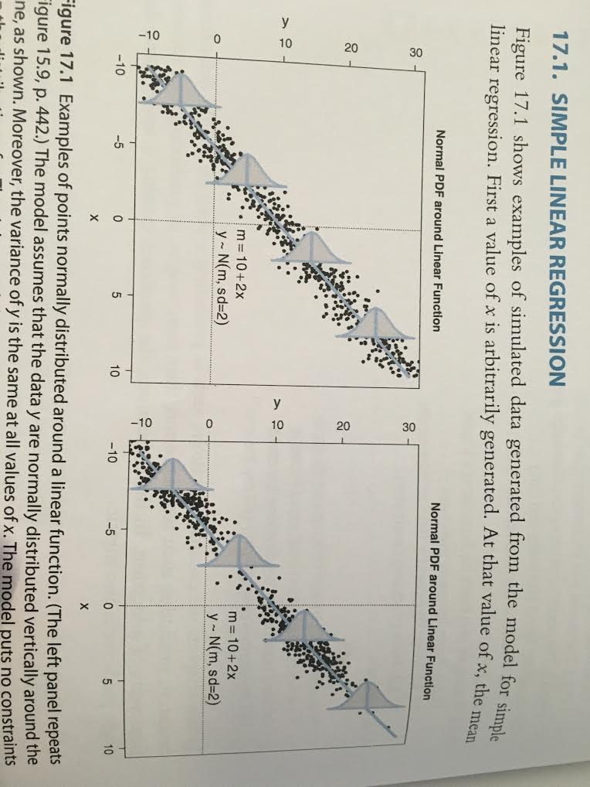
Constructing the Model
Once β₀ and β₁ are known, we construct distributions around the central tendency.
μ_{i} = β₀ + β₁*x_{i}
The normal distribution varies as follows:
y_{i} ~ N(μ_{i}, σ)

Slide 6
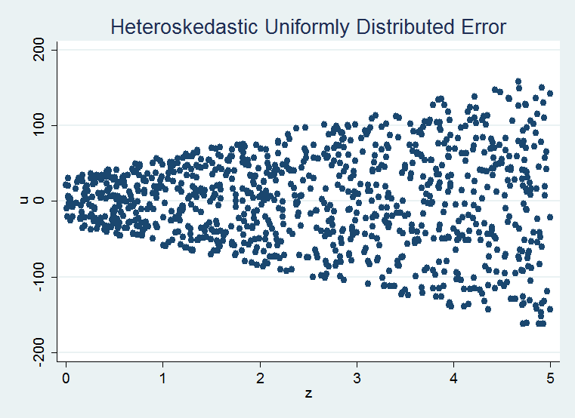
Constructing the Model
OLS assumes homogeneity of variance, or absence of heteroskedasticity.
Heteroskedastic
Homoskedastic
Evenly Distributed
Homoskedastic
Bimodally Distributed

Slide 7
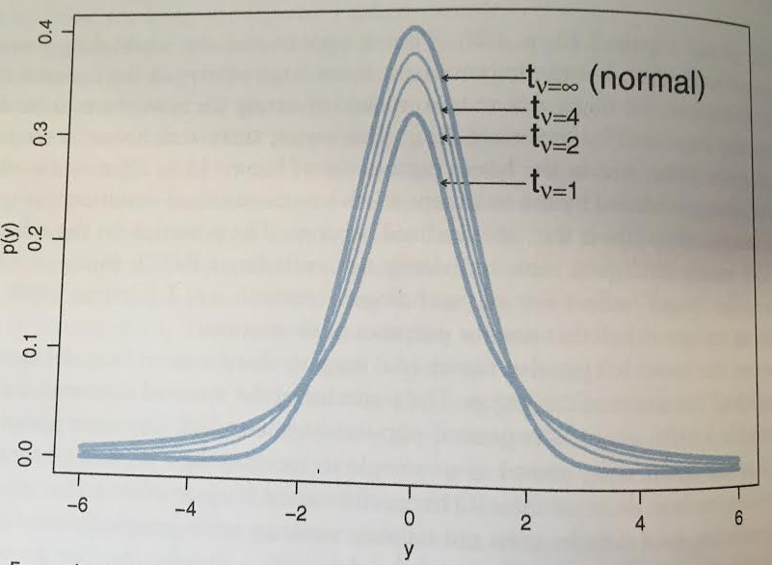
Using Student Distribution
The Student-t Distribution generalizes the Normal Distribution
y ~ T(μ, σ, v)
As v (degrees of freedom) approaches infinity, it approximates the Normal
T(μ, σ, v = ∞) = Ɲ(μ, σ)
We will here use the T distribution instead of the Normal Distribution to more easily accommodate outliers (heavier tails)

Slide 8
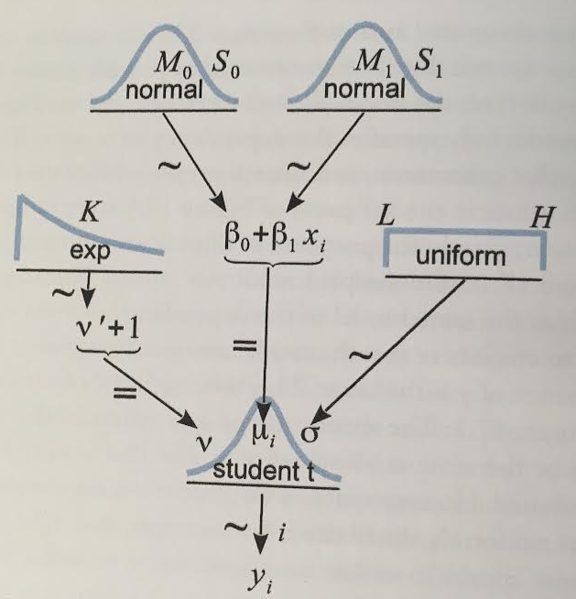
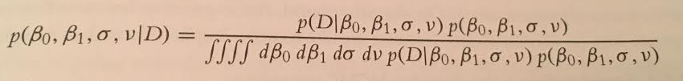
Bayesian Model
The core of OLS Linear Regression is setting μ_{i} = β₀ + β₁*x_{i}
With this hierarchical model, we must shmear probability mass across the space of four parameters: β₀, β₁, σ, v
To discover how these parameters update on the data, we use MCMC to approximate Bayesian inference:

Slide 9
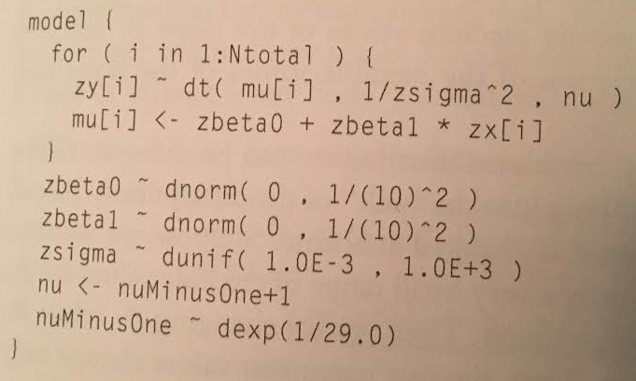
Bayesian Model
To import our model into JAGs, we simply transcribe our graphic into code:
The “z” prefix denotes standardized data, explained later

Slide 10
Data Normalization
In frequentist OLS, it is considered best practice to mean-center your IVs:
X’ = X - μ_{x}
For Bayesian Inference, we will go a bit further & standardize:
X’ = (X - μ_{x}) / σ_{x}
What’s the point?
Mean Centering: Decorrelates parameters
Normalization: priors less sensitive to scale of the data

Slide 11
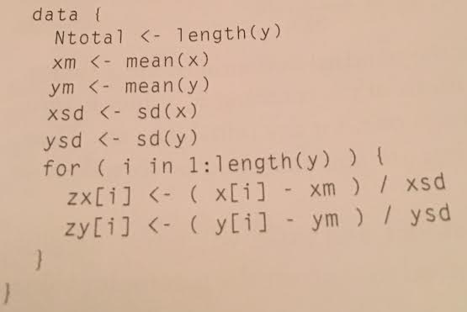
Where To Normalize?
R
JAGS
Recall division of labor between R & JAGS.
Normalization in R is trivial enough.
However, JAGS also provides a data manipulation interface.
Benefit of normalizing in JAGS:
Diagnostics are easier to consume
Graphics
MCMC
Diagnostics
Example

Slide 12
Bayesian Linear Regression
JAGS Implementation

