Slide 1
Bayesian ANOVA
Chapter 19

Slide 2
Frequentist 1-Way ANOVA

Slide 3
Generalized Linear Model
Important Variable Descriptors:
Independent vs Dependent
Cardinal vs Ordinal vs Categorical
GLM
Linear Regression and ANOVA are closely related.
In fact, they are both special cases of a more general family of models:
Generalized Linear Model (GLM)
ANOVA
Linear
Regression
Categorical
Predictor
Variable(s)
Continuous
Predictor
Variable(s)

Slide 4
Hypothesis Test Flow Chart
Categorical
𝜒² Test
DV Type
Continuous
Linear
Regression
Continuous
IV Type
2
t-test
Wilcoxon Rank-Sum Test
Categorical
Size of
IV Domain
1
One Way
ANOVA
Kruskal-Wallis
>2
Number of IVs
>1
Factorial
ANOVA

Slide 5
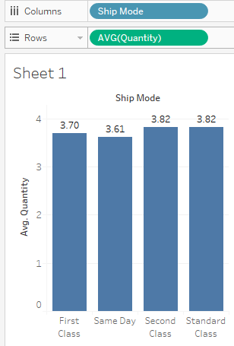
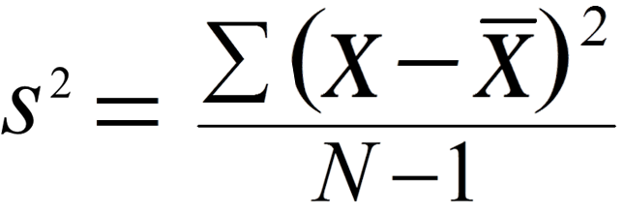
Motivations
1-way ANOVA is a way to formalize an A/B test.
ANOVA = ANalysis Of VAriance
Sum of Squares
Degrees of Freedom
ANOVA separates variance into two pieces.
s²_{within}
s²_{between}
If ratio is too high, reject H₀ .
Does Ship Mode effect Quantity?
Or, is this just a random fluctuation?

Slide 6
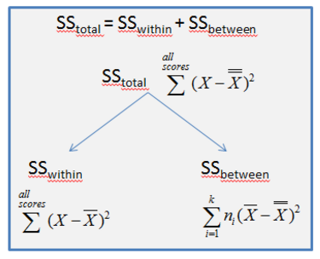
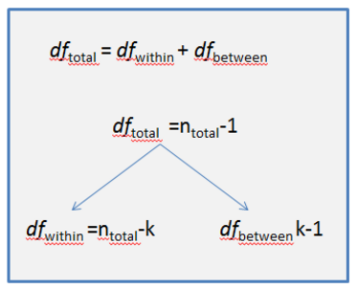
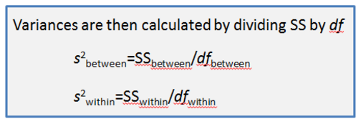
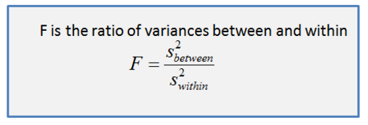
Five Steps
1
2
3
4
5
Evaluate
H₀

Slide 7
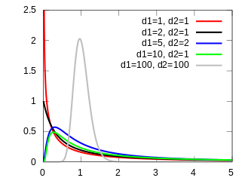
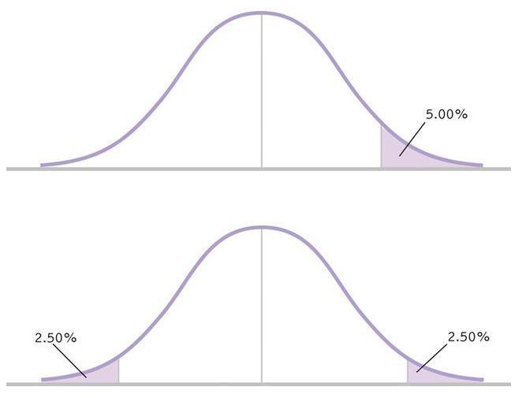
The F Distribution
Two parameters
F(df_{between}, df_{within})
In contrast to t(μ,σ,v) distribution, F values are always non-negative.
Recall one-tailed vs two-tailed tests...
Because F is non-negative, it is always a one-tailed test. You test whether F > F_{crit}
∫F(df_{between}, df_{within}) = 0.95, evaluated on [0, F_{crit}]

Slide 8
1-Way ANOVA
Worked Example (link)

Slide 9
Bayesian 1-Way ANOVA

Slide 10
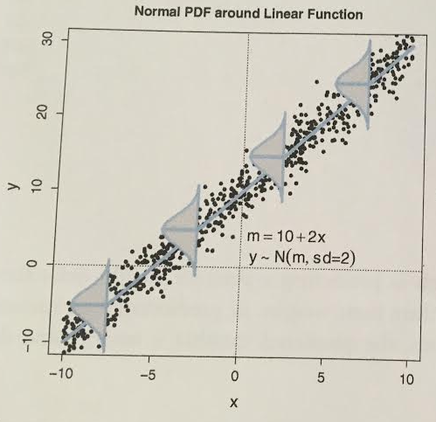
Review: Linear Regression
Once β₀ and β₁ are known, we construct distributions around the central tendency.
μ_{i} = β₀ + β₁*x_{i}
The normal distribution varies as follows:
y_{i} ~ N(μ_{i}, σ)

Slide 11
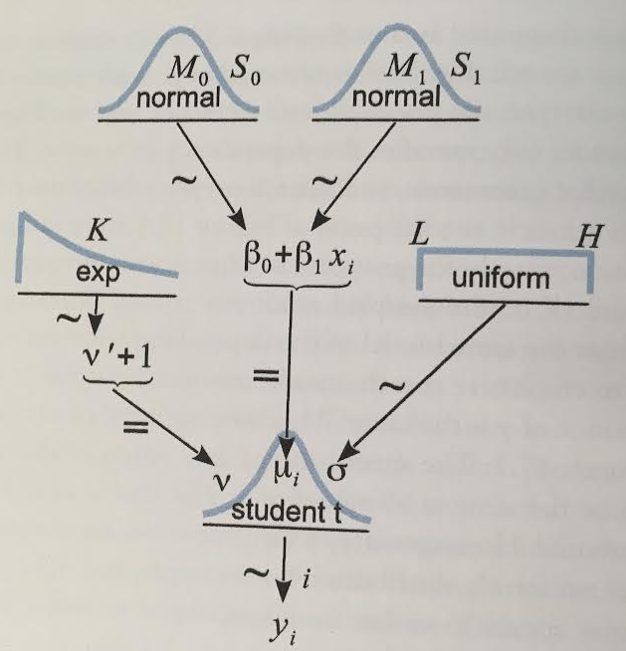
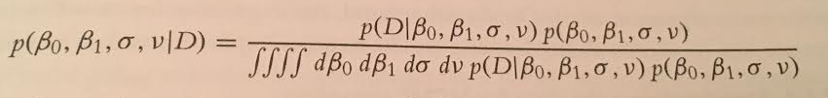
Review: Linear Regression
The core of OLS Linear Regression is setting μ_{i} = β₀ + β₁*x_{i}
With this hierarchical model, we must shmear probability mass across the space of four parameters: β₀, β₁, σ, v
We use MCMC to update our beliefs about these parameters:

Slide 12
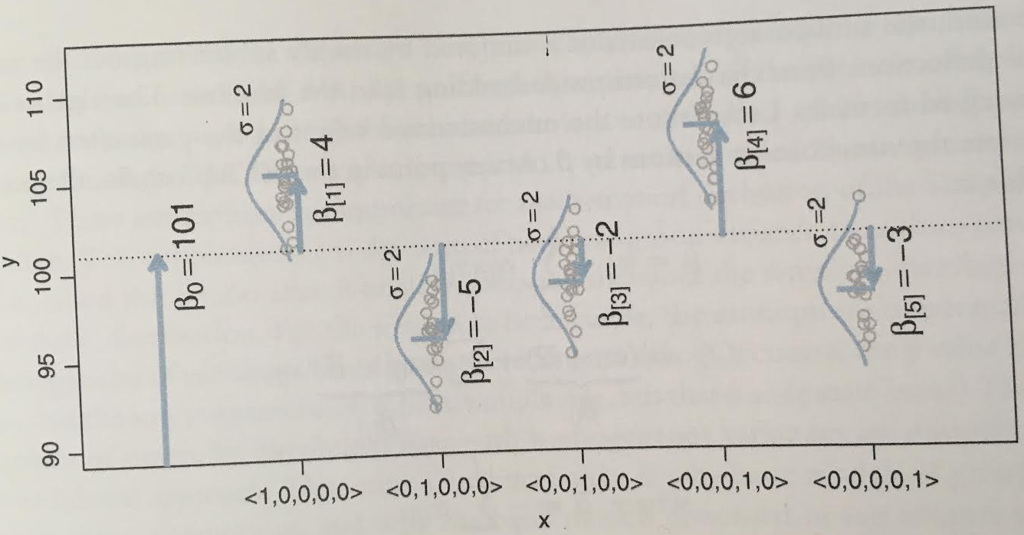
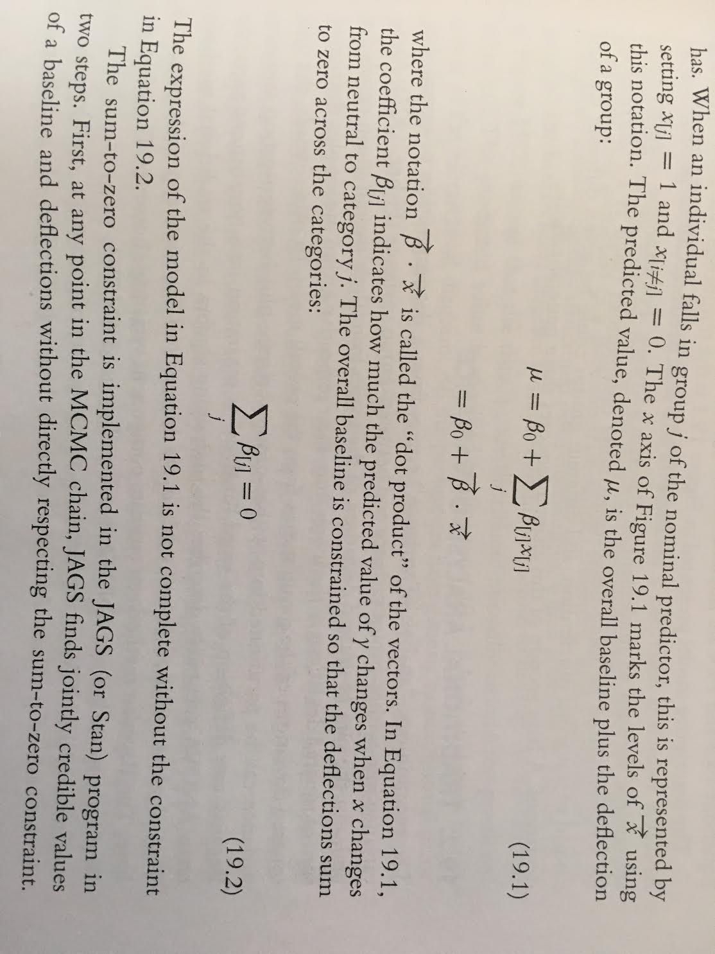

ANOVA in a vector space
For ANOVA, replace multiplication with dot product:
Each category is an orthogonal dimension
Grand Mean is your starting vector.
Category means are local vector additions.

Slide 13
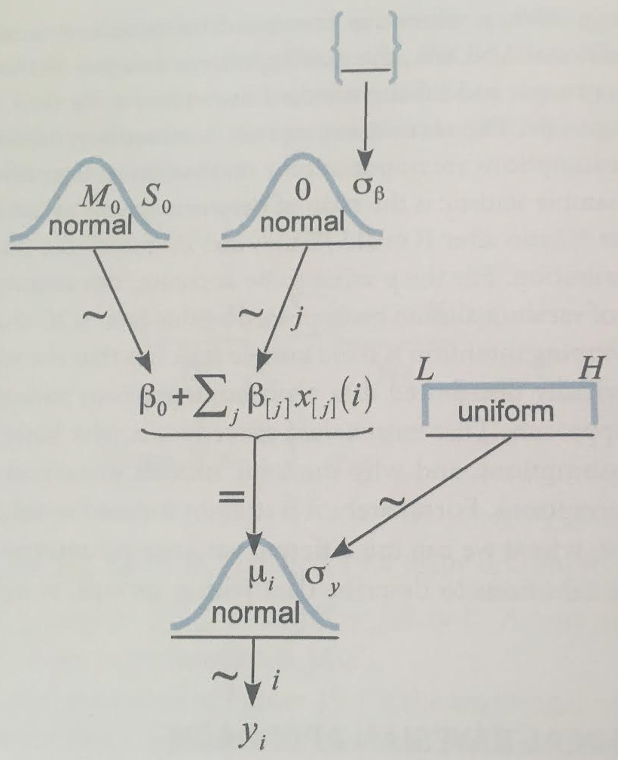
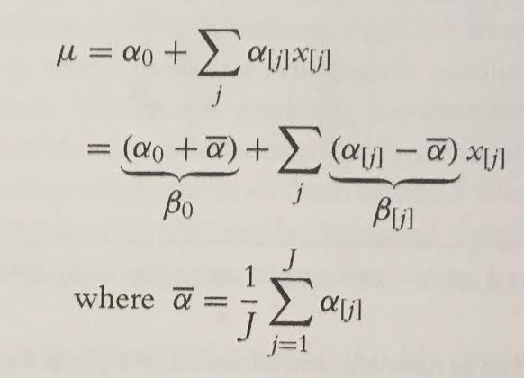
ANOVA as a Hierarchical Model
Several proposals on how to model σ_{β}:
Folded-t (Gelman, 2006)
Gamma Distribution w/ non-zero mode
Constraint: we must “normalize” our beta parameters such that they sum to zero.
To do this, our beta params depend on alpha params:

Slide 14
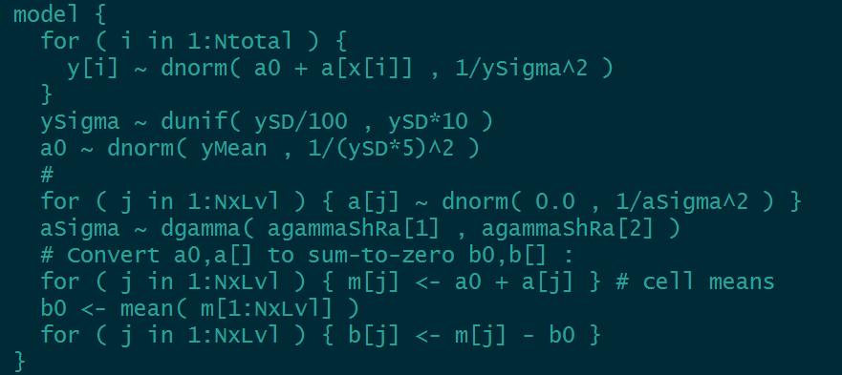
Translating to JAGS

Slide 15
Scenario
Consider Life span of male fruit flys, categorized by their sexual activity.
PregnantN represents males accompanied by N pregnant females.
VirginN represents males accompanied by N virgin females

Slide 16
Bayesian ANOVA
JAGS Example (Jags-Ymet-Xnom1facMnormalHom-Example.R)

Slide 17
Bayesian vs Frequentist ANOVA

Slide 18
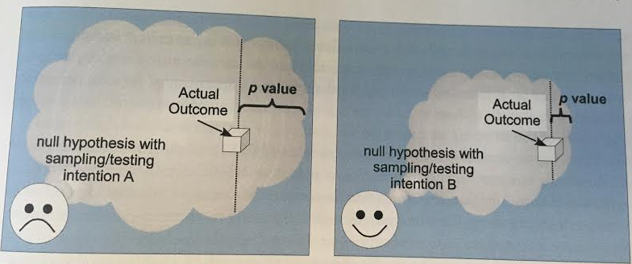
P-values change with Intention
Fundamentally, the sample distribution is a space of all possible outcomes.
The space of all possible outcomes changes by experimenter intention.
Different stopping/test intentions will alter the cloud, and the p value.
The p-value is compared against 𝛂 (false positive tolerance), which typically is 0.05

Slide 19
Frequentist Multiple Comparison
In frequentist ANOVA, imagine we reject H0: the means are not all the same.
But we aren’t done! If there are deviations, we will often want to zoom in to compare two categories w/ a t test
(N choose 2) t tests we could run.
But with m tests, we must use Bonferroni correction, 𝝰 / m. This makes it harder to achieve significance.

Slide 20
Supplementary Material

Slide 21
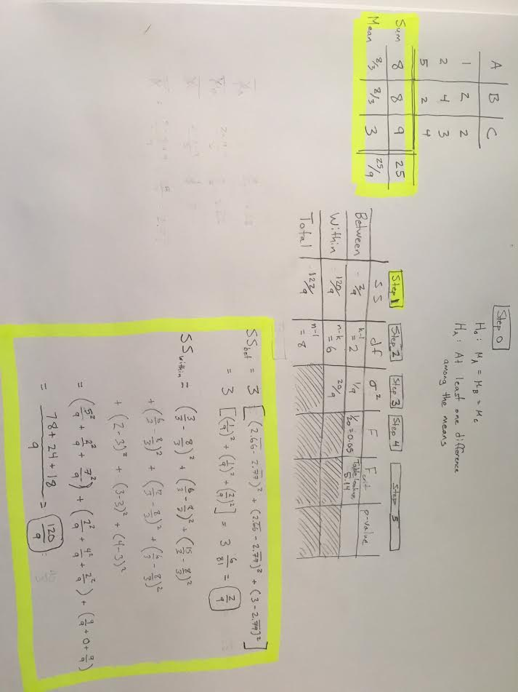
Frequentist 1-Way Anova: Worked Example

